Slide 1
Joomla! Updates and Tips
Northern Virginia Joomla Users Group
April 2020
Dorothy Firsching, Ursa Major Consulting, LLC
dfirsching@ursamajorconsulting.com

Slide 2
Agenda
Joomla! Updates
Upcoming JUG Meetings
Program – Suggestions?
  More Gantry
  Custom Fields
  What do you want to show?
Topics for Future - Discussion

Slide 3
How to Make More Money WITH JOOMLA!
Maintaining Joomla Websites

Slide 4
Classic Problems
Website is developed
  Updates are neglected
  Website is out of date / not backed up
  Hacks occur…
Website is developed on the cheap
  Maintainer isn’t too experienced
  Backups are not made
  Oops…
These updates come out all the time!
  But it costs too much in $ or time to do them as they occur!

Slide 5
Result
Neglected sites, particularly for low-budget organizations
Dedicated developers do updates out of goodwill, uncompensated
Clearly, the big customers have figured out that they need to maintain and pay to do it

Slide 6
Contractual Coverage for Maintenance
Include in development bid:
  Fixed monthly retainer for maintenance
  Hourly rate
  Fixed amount to draw down against
  Dedication – just do it
Including:
  Hosting
  Core and extension updates
  Backups
  Security Audits
  User Support
  Site Content Assistance
  Minor Tweaks
What have you used? What has worked / not worked so well?

Slide 7
Client Management Issues
Client thinks websites are done when paid for
Client likes to gab, eats up time but doesn’t consider that billable
Client hires a ‘technical’ person who wants plenty of help
Your experience?

Slide 8
Joomla Core and Extension Updates
Login
Backup
Install
Test
Login
Backup
Install
Test
Login
Backup
Install
Test
Login
Backup
Install
Test
Website
Website
Website
Website
. . . . Tedious?

Slide 9
Dashboard Tools
MySites.guru (myJoomla)
BackupMonkey.io
Watchful
YourSites
Central Dashboard to Manage Sites
Could save time
But not free
Other features, too
Website
Website
Website
Website

Slide 10
Functional Comparison
Capability | MySites | Watchful | Backup Monkey | YourSites
Central Dashboard | Yes, can save parameters, passwords, log in to site backend | Yes | Yes | Yes
Core and Extension Updates | Yes can see updates needed | Yes | Yes | Yes
Automatic Extension Updates | Yes, can set to automatic | Yes | Coming soon | No
Backup Management | Yes | Yes | Yes | Yes
Automated Backup Scheduling | Yes | Yes | Yes | Yes
Uptime Monitoring | Yes; Uptime robot | Yes | Yes | Yes
Site Audits | Yes | Yes | No, planned | Yes
Remote Installer | No | Yes | No | Yes

Slide 11


Other aspects
Knowing the person who runs myJoomla.com, I trust that service absolutely. He's someone who's even more paranoid about security than me – and I'm pretty deep into the tinfoil hat wearing territory. – Nicholas Dionysopoulos
Capability | MySites | Watchful | BackupMonkey | YourSites
Type of Service | Hosted service | Hosted service | Hosted service | Joomla Extension
Location of Ownership | Great Britain | USA | Germany | Self Hosted, but created in Great Britain
Founder | Phil Taylor | John Singleton and Shayan Mohanty | Robert Deutz David Jardin | Geraint Edwards (JEVENTS, EasyLayouts)
Reviews |  | Used by Joomlashack | ? Seems new
Strengths | Site Audits; added updates | Site Updates; added audits | Site Updates | You control it all
Additional capabilities | Will fix hacks | Google analytics reports for clients; client extension | BackupTesting at extra cost
WordPress? | Yes, WordPress Support | Yes, WordPress Support | No | Yes, WordPress and ClassicPress
Security | Nick of Akeeba trusts Phil. | Yes

Slide 12
Price Comparison
Level | MySites (Service) | Watchful (Service) | Backup Monkey (Service) | YourSites (Extension)
 | https://mysites.guru/pricing/ | https://watchful.net/pricing | https://backupmonkey.io/en/pricing | https://www.yoursites.net/pricing/levels
Entry level | 5.00 £/month ($6.20) 1 site Unlimited audits Unlimited backups | $4.99/month 5 sites | 6,00 € /mo ($6.49) 15 sites 0,10 € /mo Scheduled backups ($.11) 0,10 € /backup up to 2GB | 40.00 £/ 3mo ($49.57) 65.00 £/6 mo ($80.54) 100.00 £/12 mo ($123.91) Up to 50 sites (equates to $10.32/mo)
5 Sites | Same as unlimited | $4.99/mo | 6,00 € /mo ($6.49) 15 sites | Same as basic
30 sites | Same as unlimited | $19.99/mo | 10.50 € /month ($11.37) 30 sites | Same as basic
Unlimited Sites | 19.99 £/month ($24.77) 199.99 £ / year ($20.65/mo if pd annually) | $38.99/mo up to 50 $74.99/mo up to 100 | No unlimited plan | 150.00 £/ 12 mo ($185.87) (equates to $15.48/mo.)

Slide 13
Estimated Annual Cost
Level | MySites (Service) | Watchful (Service) | Backup Monkey (Service) | YourSites (Extension)
1 site, paid annually | $ 74.40 | $59.88 | $77.88 | $123.91
5 Sites, paid annually | $247.80 | $59.88 | $77.88 | $123.91
30 sites, paid annually | $247.80 | $239.88 | $136.44 + storage | $123.91
Unlimited Sites | $247.80 | $899.88 but only 100 sites | ? | $185.87

Slide 14
Add:
How to configure updates / what extensions to auto-update
How to configure backups / where to put them
How to calculate time into contract for maintenance
What about content updates, maintenance tweaks, audits, audit reviews, testing?

Slide 15
Maintenance Contract
What should be included?
  Hosting
  Core Updates
  Extension Updates
  Extension Costs
  Automated Backups / Backup Management
  TESTING
  Test site
  User Support
  Audits / Review of Audits
  Performance Reviews / Tuning

Slide 16
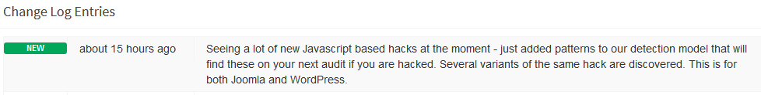
Mysites.guru (myjoomla.com)
Strong Features
  Automatic Audits for Hacks
  Tracks Core and Extension Updates
  Tracks Php versions, SSL
  Tracks Good Practices
  Scheduled Backups
Frequent updates

Slide 17
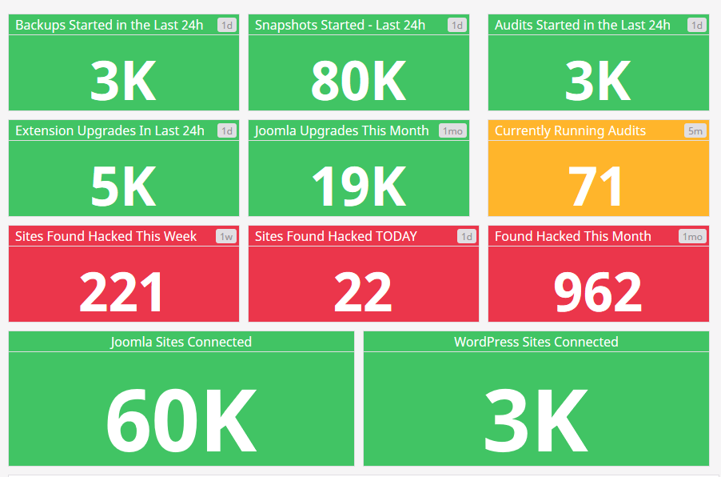
Mysites live stats

Slide 18
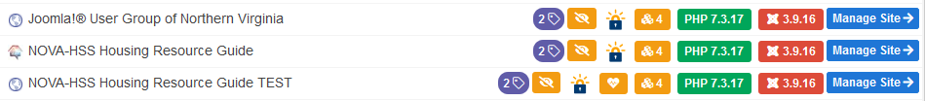
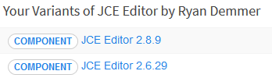
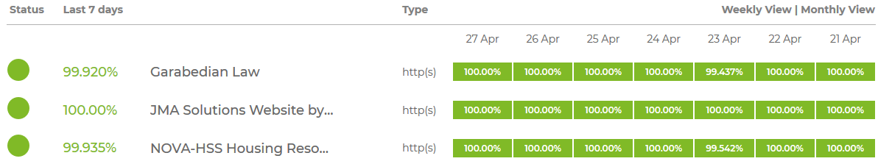
Advantages of Dashboard Tools
Show you what needs updating (mysites)
Install Upgrades
Run Backups
Monitor Uptime

Slide 19
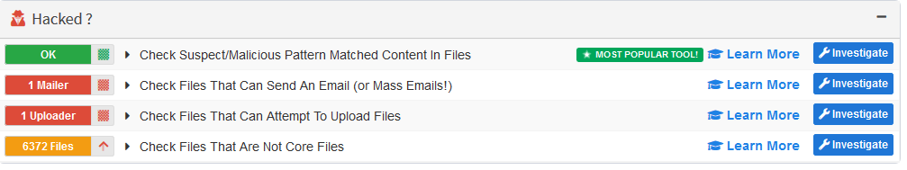
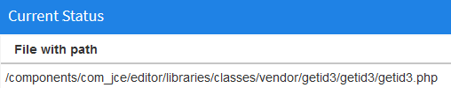

Advantages of Dashboard Tools
Run Audits (mysites)
  Understand false positives
Important!
- Can send an email
- Can upload files

Slide 20
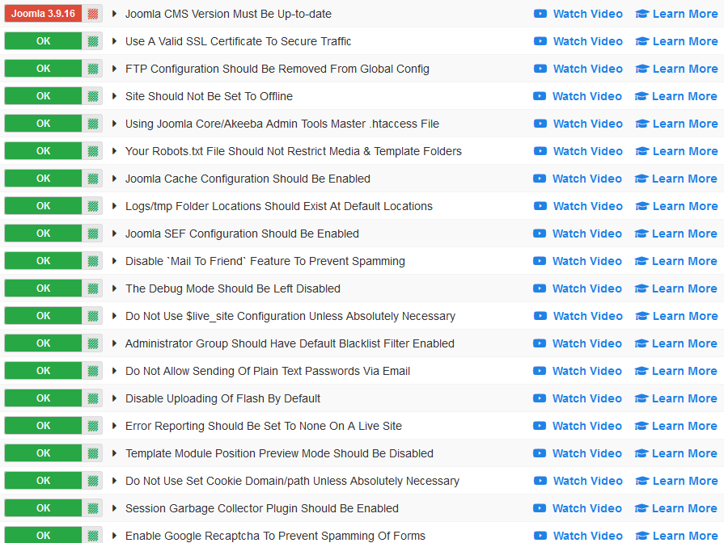
Advantages of Mysites
Support for good practices (excerpt!)

Slide 21
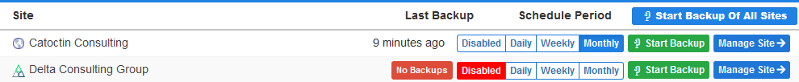
Backups
Get Akeeba Backup Pro
Configure Backup Profile
  Full or Database Only
  Destination of Backup – Dropbox, Amazon S3, etc.
Connect Profile to Dashboard
Schedule Backups through Dashboard

Slide 22
Automatic Updates
Is the site backed up at the right time?
Do you trust the developer?
  JCE
  Akeeba Backup
  Akeeba Admintools
  …
What is your comfort level?

Slide 23
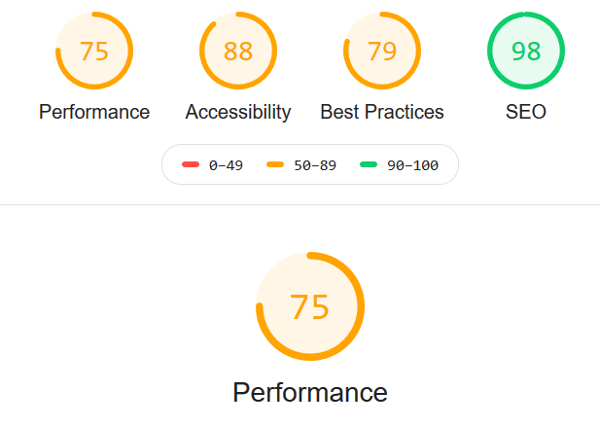
Performance Audit
https://developers.google.com/web/tools/lighthouse
Inside of mysites

Slide 24
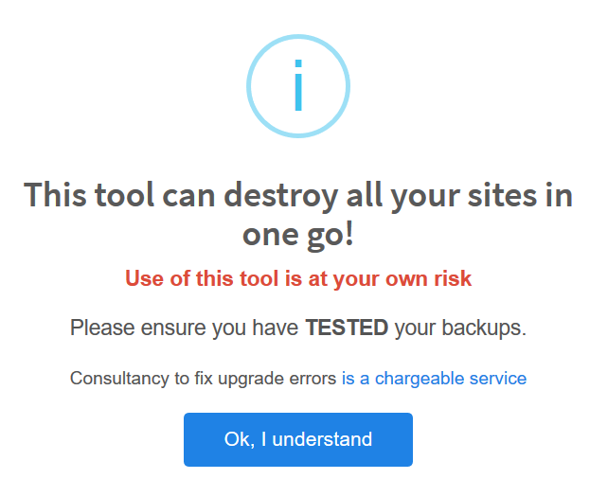
Disadvantages of Dashboard Tools
Risk:
  Mass Upgrade Sites
  Remote Install Extension to
  multiple sites
Comfort Level
  Need to visit your sites!

