Slide 1
Google Lighthouse and Joomla Performance
Northern Virginia Joomla Users Group
August 2020
Dorothy Firsching, Ursa Major Consulting, LLC
dfirsching@ursamajorconsulting.com

Slide 2

Google Lighthouse and Joomla! Performance

Slide 3

Website Development Processes
Define objectives and target audiences
Determine content
Select structure
Design navigation
Design look and feel
Test
Implement and Train
Maintain
What about:
Performance?
Accessibility?
Search Engine Optimization?
Security?
Best Practices?

Slide 4
Lighthouse
Open-source, automated tool for improving the quality of web pages.
Run it against any web page.
Audits for performance, accessibility, progressive web apps, SEO and more.
Runs in Chrome DevTools, from the command line, or as a Node module.
Use results to improve the page.

Slide 5
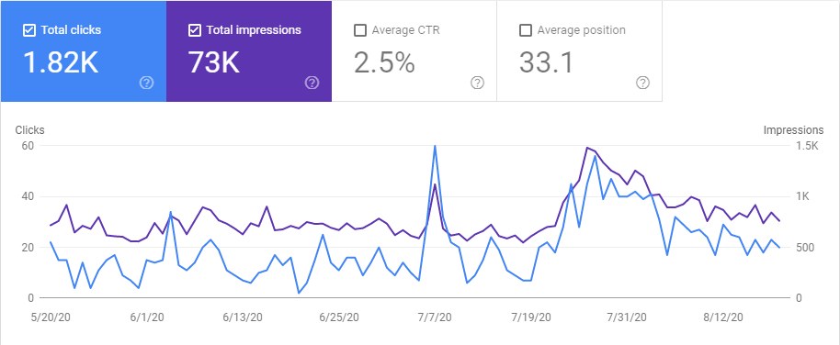
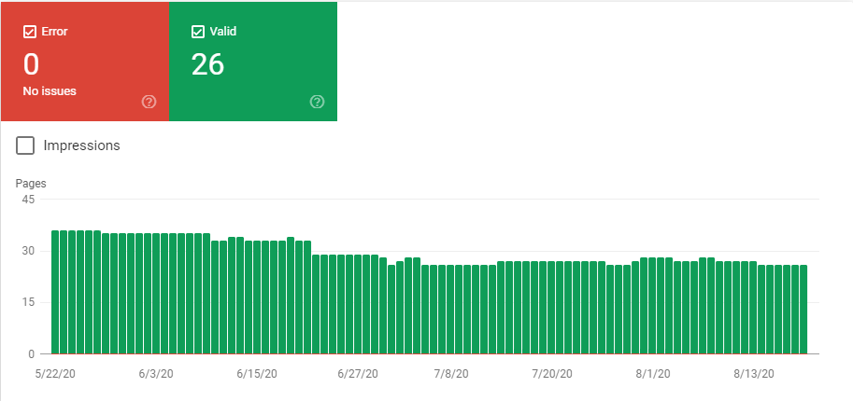
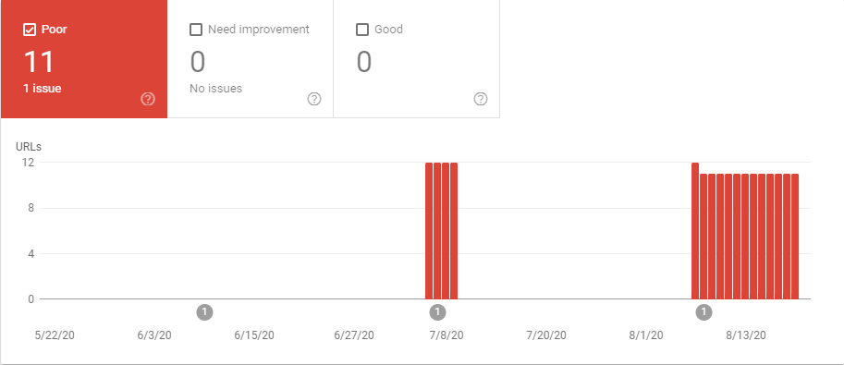
Google Search Console
Performance is OK
Coverage is OK
Sitemaps are OK
No security issues
Mobile usability OK
Core Web Vitals – WHAT?
  “LCP issue: longer than 4s (mobile)”

Slide 6
Google PageSpeed vs Lighthouse
PageSpeed Insights
  https://developers.google.com/speed/pagespeed/insights/
  Measures the “Performance Metric” only
  Uses a “combo” of lab and real-world data
  Uses the Lighthouse “integrated analysis engine”
Lighthouse
  “Uses lab data only (under consistent conditions)”

Slide 7
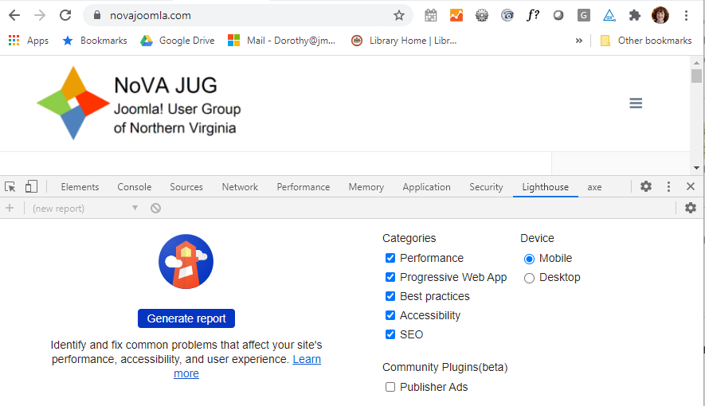
Using Lighthouse via Chrome
More tools → Developer Tools → Lighthouse tab
Or just press F12

Slide 8
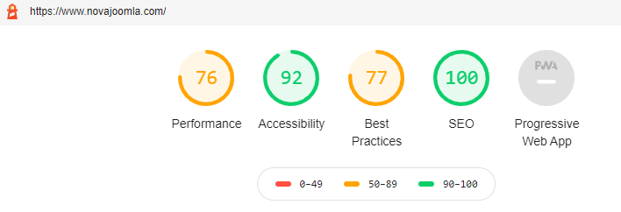
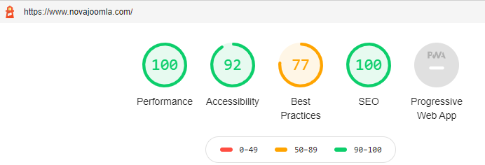
Look at both Mobile and Desktop
Mobile is the default / worse performance
  Mobile:
  Desktop:

Slide 9
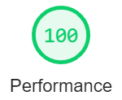
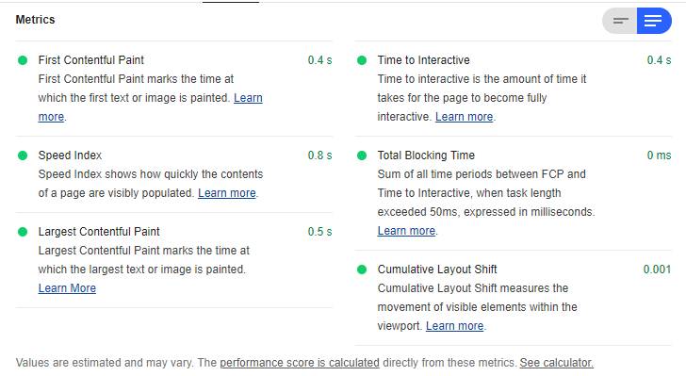
Performance Measures
Blue selector / read more for explanations
Novajoomla on DESKTOP:

Slide 10
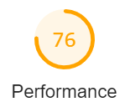
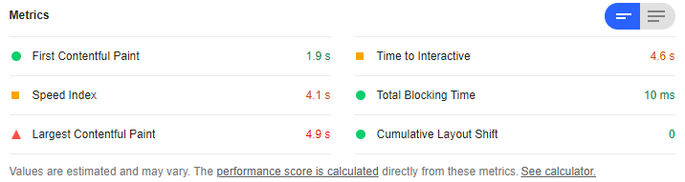
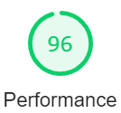
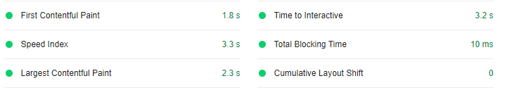
Performance Measures
Blue selector / read more for explanations
Novajoomla on MOBILE:
With a few fixes, I got it up to 96:

Slide 11
PageSpeed Insights vs Lighthouse
Sometimes HUGELY different results.
  https://github.com/GoogleChrome/lighthouse/issues/6708
  “It's a highly useful tool, but it should be used with a grain of salt.”
  “PSI web never reports the same score twice, even for the same page”
  “The two scores differ (lighthouse vs web), even though they are based upon the exact same source code (geographic location, network speed, latency, and cpu power differ)”
  “If you run Lighthouse on a slower cpu speed pc, and on a more powerful one, the score change is massive and it reports problems with completely different aspects of the page”
“In the real world, SEO companies use PSI. LH not to be taken seriously. All devs proudly showing scores on Twitter are basically proud of having fast hardware.”
It has been suggested to click “clear all”: this icon:
Also different scores from LH available through mysites.com

Slide 12
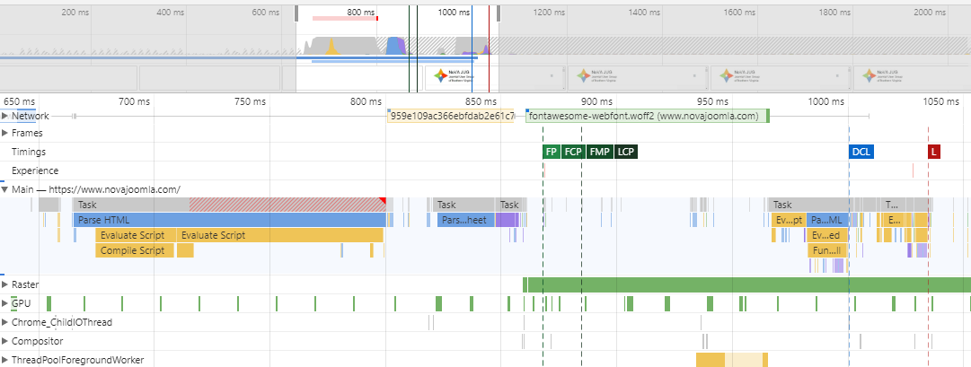
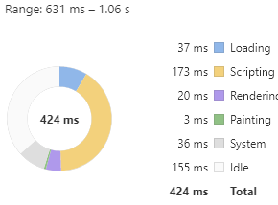
Click “View Trace”
FCP = First Contentful Paint
Gets complicated…
Back to Lighthouse!

Slide 13
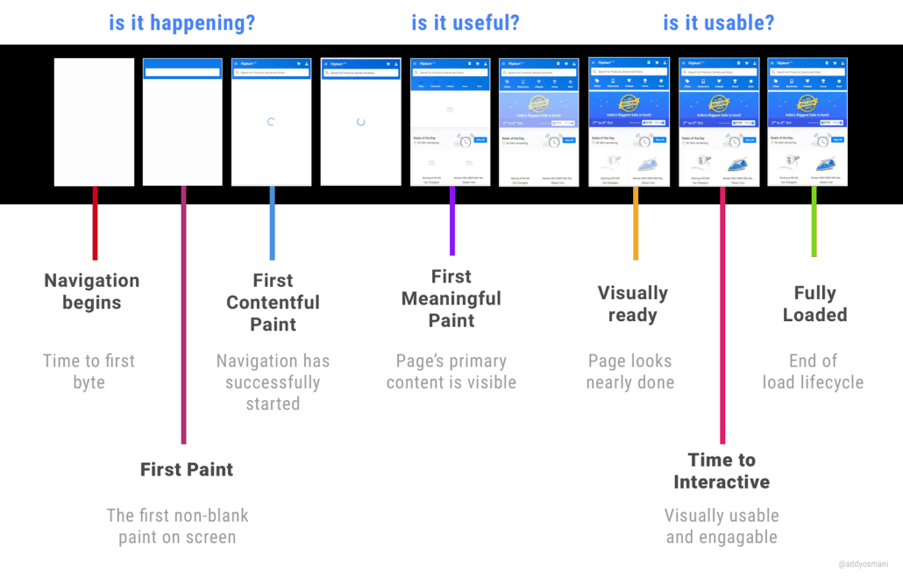
Page load on Mobile
From: https://suncityadvising.com/wp-content/uploads/2018/06/Page-Load-Pagespeed-performance-1030x659.png

Slide 14
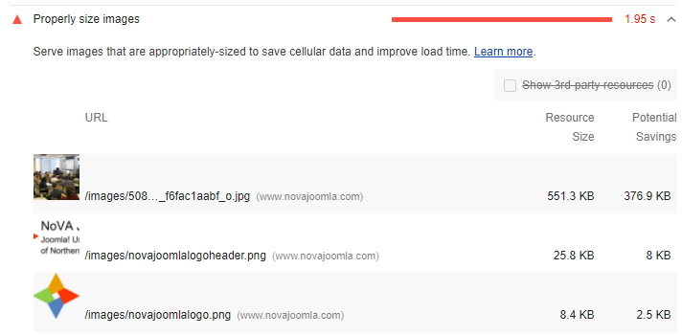
Performance Recommendations
Properly size images
Joomladay – Fixed, but it says it can be smaller still
From Meetup
Logo – Fixed

Slide 15
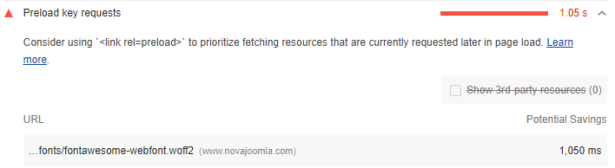
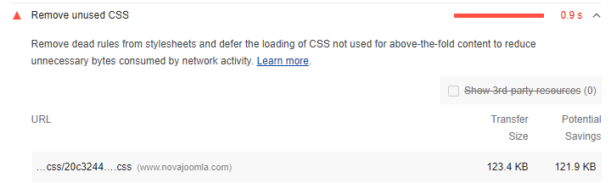
Performance Recommendations
Preload key requests
Remove unused CSS

Slide 16
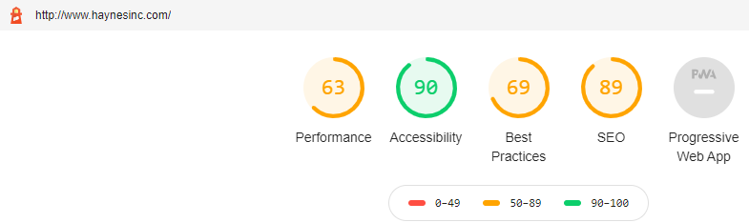
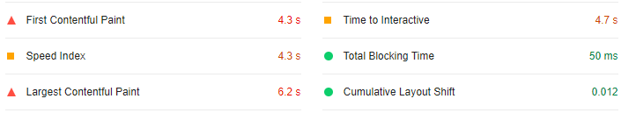
This site has lower performance
Let’s review recommendations

Slide 17
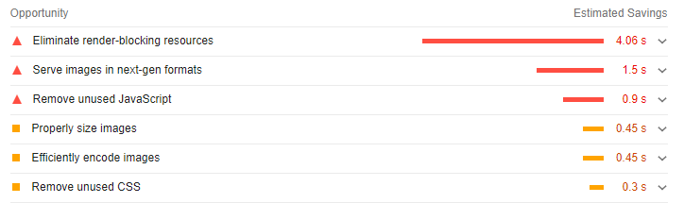
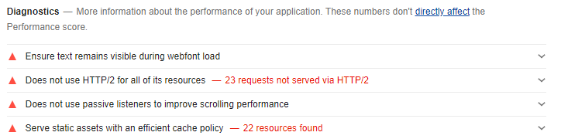
Performance - Opportunities

Slide 18
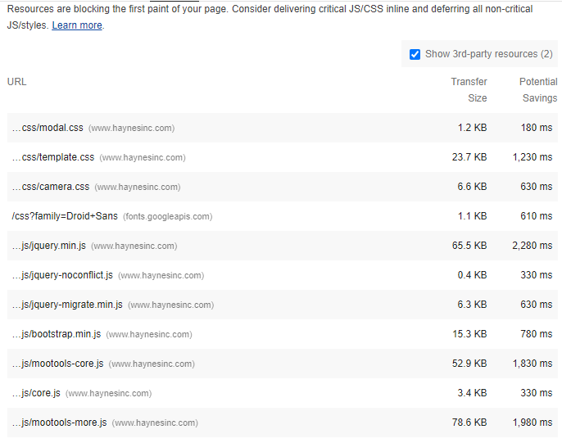
Performance (1)
Eliminate Render-blocking resources
Gobs of css and js files here
Also Google fonts
Typically a template issue
Template may offer tools to combine, minify, defer the css and js
If not, extensions exist, e.g., JCH Optimize

Slide 19
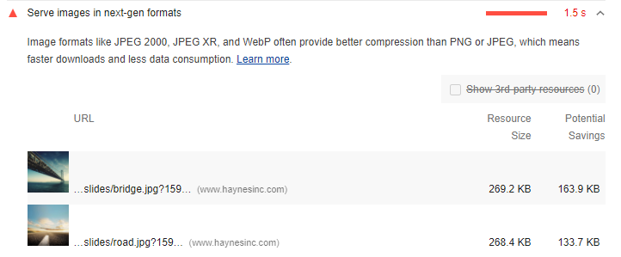
Performance (2)
Serve Images in Next-Gen Formats
How do we do that, and is it advisable?

Slide 20
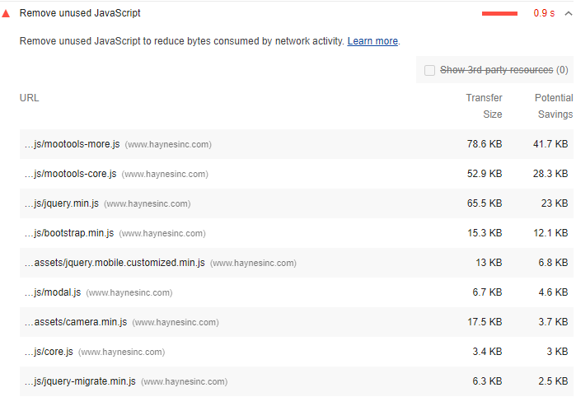
Performance (3)
Remove unused Javascript
Hard to do this if part of a template
If it is part of an unused extension, uninstall it!

Slide 21
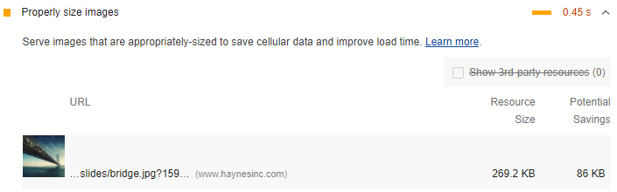
Performance (4)
Properly Size Images
  This will catch oversized images – resize them, don’t resize in browser
  But serving multiple image sizes for mobile and desktop = more challenging

Slide 22
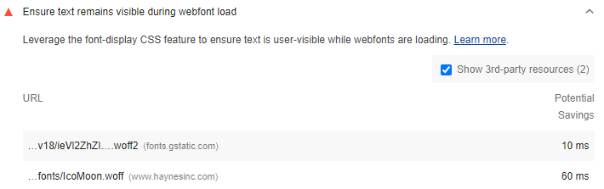
Performance (5)
Ensure text remains visible during webfont load
Again, often a template issue
Preload web fonts #
Use <link rel="preload"> to fetch your font files earlier.
Add the &display=swap parameter to the end of your Google Fonts URL:
<link href="https://fonts.googleapis.com/css?family=Roboto:400,700&display=swap" rel="stylesheet">

Slide 23
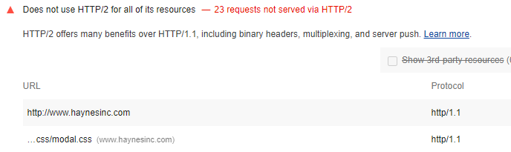
Performance (6)
Does not use HTTP/2 for all of its resources
Typically a server / site hosting consideration
Must be enabled on the server

Slide 24
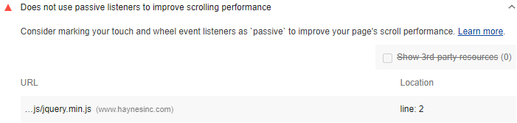
Performance (7)
Does not use passive listeners to improve scrolling performance
Supposedly works in most browsers
https://developer.mozilla.org/en-US/docs/Web/API/EventTarget/addEventListener#Browser_compatibility

Slide 25
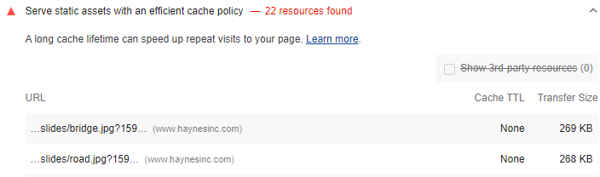
Performance (8)
Serve static assets with an efficient cache policy
Can be done in .htaccess
Admintools offers an option

Slide 26
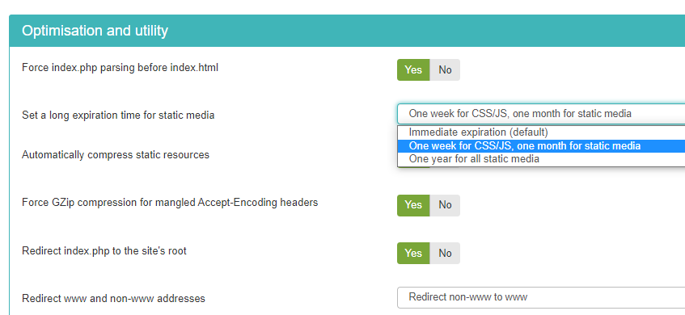
Performance: Admintools Pro
Set long expiration for static resources
Automatically compress static resources

Slide 27
Performance: Joomla Topics
Gzip compression
Caching – a whole topic unto itself
Lightweight templates
Template performance tools
JCH Optimize or other performance tools
CDNs, faster hosts

Slide 28
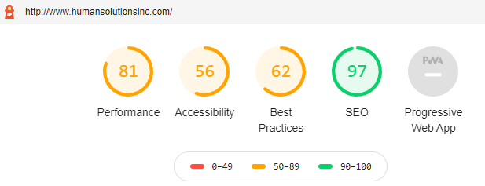
Accessibility: Many Checks
This one could use some help:

Slide 29
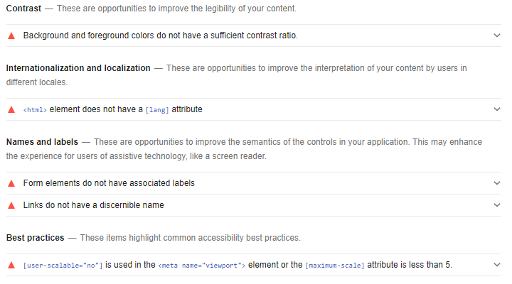
Accessibility
Only a subset of accessibility issues can be tested

Slide 30
Accessibility Examples
Background and foreground colors do not have a sufficient contrast ratio
Form elements do not have associated labels
Disabling zooming is bad
Images should have alt tags
Heading elements not in sequentially-descending order
Video elements should have captions and descriptions
Links without a discernable name – e.g., nothing, “click here”, etc.
Tap targets are too small – need to be 48px x 48px or larger
Tips are given for manual review of other aspects

Slide 31
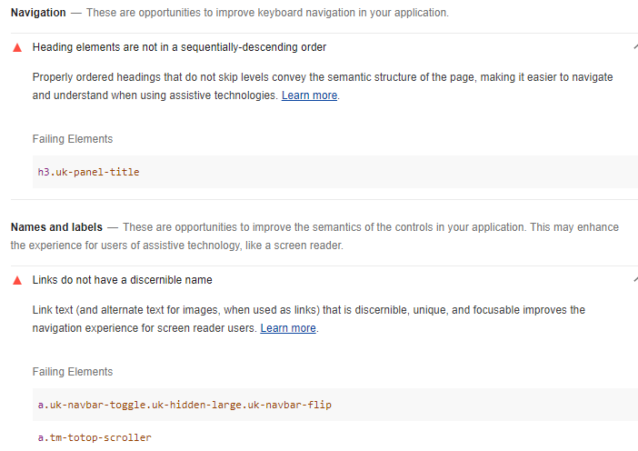
Accessibility - Novajoomla
Uhh, these are part of the template

Slide 32
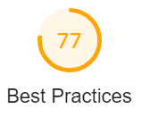
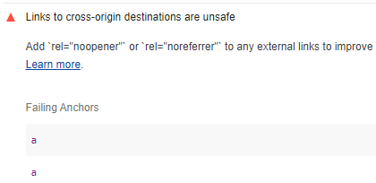
Best Practices
Novajoomla site:
Links to cross-origin destinations are unsafe
  Linking to a page on another site using the target="_blank" attribute, you can expose your site to performance and security issues
  The other page may run on the same process as your page. If the other page is running a lot of JavaScript, your page's performance may suffer
  The other page can access your window object with the window.opener property. This may allow the other page to redirect your page to a malicious URL. Adding rel="noopener" or rel="noreferrer" to your target="_blank" links avoids these issues.
These turned out to be inside JoomlaWorks “Simple RSS Feed Reader”
Click thru from Lighthouse to Elements

Slide 33
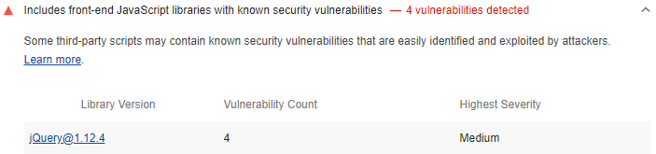
Best Practices
Novajoomla site:
Includes front-end JavaScript libraries with known security vulnerabilities

Slide 34
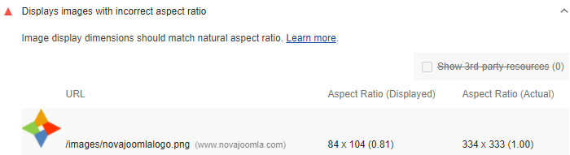
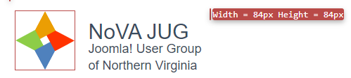
Best Practices
Novajoomla site:
Displays images with incorrect aspect ratio
But:
Was resized to 84 x 84
Exported new image as 84 x 84

Slide 35
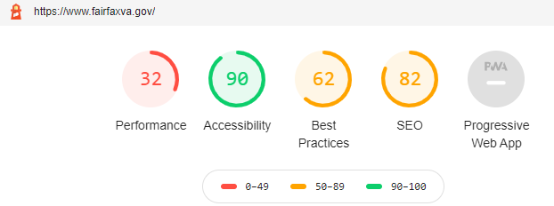

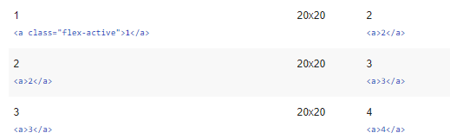
SEO examples
Document does not have a meta description
Links do not have descriptive text
Image elements do not have alt tags
Tap targets are not sized appropriately
Should be 48px x 48px

Slide 36
Overall….
It’s worth running on your sites
The recommendations will help you tune up your sites
Not sure about the validity of the performance scores – read more about it!

