Slide 1
Joomla! Updates and Tips
Northern Virginia Joomla Users Group
August 2020
Dorothy Firsching, Ursa Major Consulting, LLC
dfirsching@ursamajorconsulting.com

Slide 2
Agenda
Joomla! Updates
Upcoming JUG Meetings
Program – Lighthouse
Topics for Future - Discussion

Slide 3
Latest Joomla! Updates
3.9.21 – Tomorrow?
Joomla 4 Beta 3 – July 29, 2020
3.10 Alpha 1 – July 29, 2020
3.9.20 – July 14, 2020 – 6 security vulnerability fixes and several bugs
3.9.19 – June 2, 2020 – Security and bug fix
3.9.18 – April 21, 2020 – Bug Fix
  Fixes single tag view incorrectly showing a 404 page – oops!

Slide 4
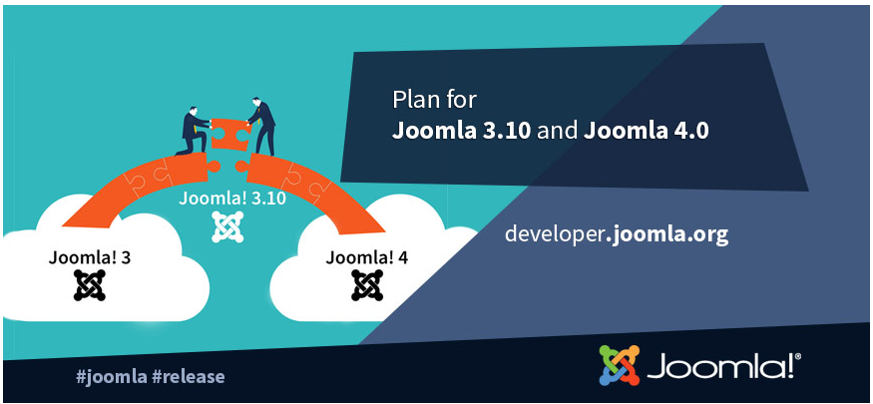
Upcoming
Joomla! Releases
Joomla! 3.10 – last of Joomla! 3.x Series – ?? 2020
  API changes prior to Joomla! 4.0
  Will be supported for 2 years after release
  Update Checker – test compatibility with Joomla! 4.0
  https://magazine.joomla.org/all-issues/may-2020/joomla-3-10-and-the-update-checker
Joomla! 4.0 beta 3 – July 29, 2020
  https://magazine.joomla.org/all-issues/may-2020/the-may-issue
  Can update to Joomla! 3.10 and then to 4.0 beta
  I installed Joomla! 4.0 beta 3 but site templates won’t work with it yet

Slide 5
Joomla! 4.0 Key Features
https://magazine.joomla.org/all-issues/may-2020/joomla-4-what-to-expect
Workflow
Media Manager
Installation – in seconds
A cleaner and more powerful codebase. With the removal of deprecated functions from Joomla 3.x and the use of PHP namespaces that allows developers to deliver more robust and innovative applications than ever before
The web is for all. We aim to ensure that the templates are accessible (Level AA of WCAG 2.1)
The power of the Joomla Framework merged into the CMS
A fully rebuilt Media Manager with a cleaner User Interface and new image editing capabilities
A new Publishing Workflow to manage your articles in an advanced and customisable way
New security features such as support for prepared SQL statements
Web Services to allow you to make your content accessible to other websites
An enhanced event dispatching system
HTML Mail Templates to allow easy customisation of the emails your site sends
An improved and expanded Command Line Interface (CLI)
Clean codebase, high coding quality, but many changes.

Slide 6
Joomla! 4 compatibility
Don’t forget that Joomla! 3.10.x will be supported for 2+ years after it is released
Joomla 4 will have a new, standard way of handling license keys:
  https://watchful.net/blog/joomla-4-license-key/
Extensions
  Akeeba Backup: Will start working on J4 after beta is released. “J3 to J4 is a FAR bigger leap than J2.5 to J3.”
  JomSocial: Built for Joomla! 1.5, upgraded. Needs to change for Joomla! 4. Plans are to support both 3.x and 4.
Templates
  JoomlArt: T4 will work for J3 and J4; will roll out templates for J4 as soon as J4 goes stable.
  Rockettheme: Gantry 4 will not be rewritten for Joomla! 4. Working on bringing most popular templates to Gantry 5, which will work with Joomla 4.

Slide 7
Updating Joomla 4
Go to System / Joomla
Click Options
  For Minimum Stability, select Beta
  For Update Channel, choose Custom URL and paste in: https://update.joomla.org/core/nightlies/next_major_list.xml.
  Save and Close
Go to Live Update / Click Install the Update

Slide 8
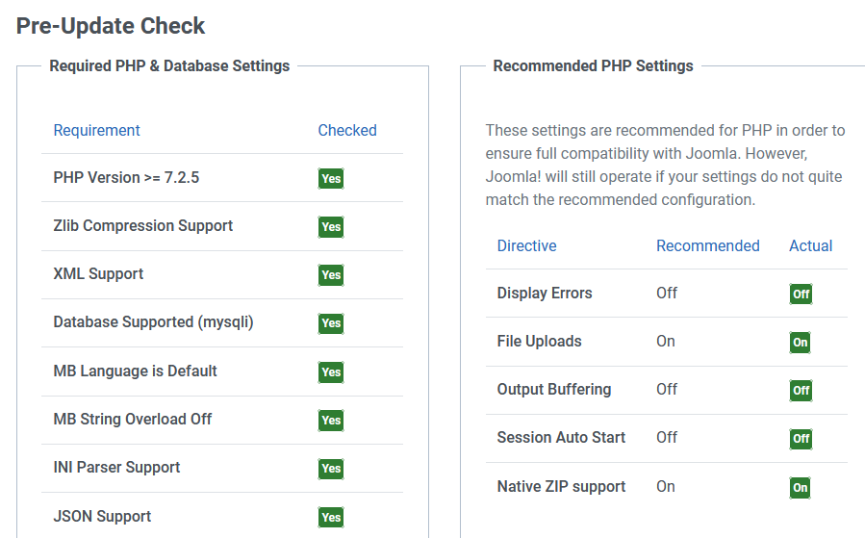
Pre-Update Check

Slide 9
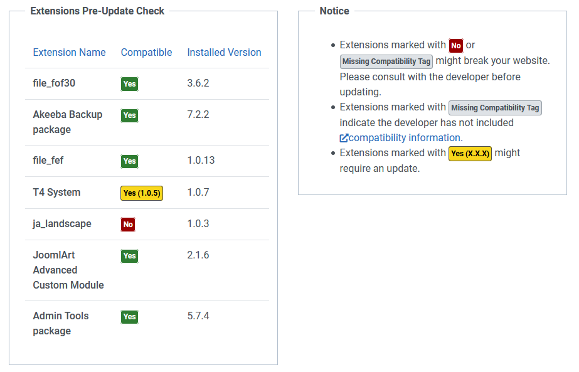
Extensions Pre-Update Check
I had already figured out that the Ja_landscape template was broken; though it said it was Joomla 4 ready!

Slide 10
Other Joomla! Events
Joomla Users Group of NJ - https://joomlausersnj.com/
  New Brunswick, NJ
JUG Chicago North (JUGCN) – joomlachicagonorth.com
  August 26,2020 – Custom Fields and External Data Sources, 2 pm our time, https://joomlachicagonorth.com/meetings/event/133-custom-fields-and-external-data-sources
  October 17, 2020: JoomlaDay Chicago
Joomla User Group Boston
  https://www.jugboston.org/meetings/event/3-keyword-research-how-it-supports-seo-as-well-as-overall-marketing-strategy -- Was in August, may have been recorded
Joomla! Users Group Long Island
  Meets monthly but no info…
Joomlashack ran weekly online events; now on their YouTube channel

Slide 11
Upcoming JoomlaDays and Conferences
JoomlaDay Austria: March 20, 2020, Salzburg (2 days)
  https://youtu.be/jbfTHAzdkBk -- IT’s ONLINE (mostly German though)
    13:30 Niels Nübel – Yootheme Pro
    1:00:59 Nadja Lamisch – Showcase: Schule mit Erfolg
    1:45:55 Irene Michl – Content Audit: wie schaut's aus?
    2:28:25 Alex Metzler – Green Webdesign
    4:13:45 Lukas Jardin – Geld verdienen mit Joomla! - Wartungsverträgen
    4:57:06 Kiki Schuelling – Customfield für Joomla erstellen
    6:12:30 Yves Hoppe – Anti Patterns 6:58:20 Allon Moritz – Lokale Entwicklung mit DpDocker
    7:42:03 Peter Martin – This is the Internet
    8:30:00 David Jardin – Forum for the Future
J and Beyond 2020: May 30, 2020 – 24 hour ONLINE event now on YouTube
JoomlaDay Germany: September 26, 2020.
Chicago: October 17, 2020

Slide 12
Upcoming NOVA JUG Events
Monday, August 24, 2020: Virtual
Monday, September 28, 2020
Monday, October 26, 2020
Topics / Speakers?

Slide 13

Google Lighthouse and Joomla! Performance

Slide 14

Website Development Processes
Define objectives and target audiences
Determine content
Select structure
Design navigation
Design look and feel
Test
Implement and Train
Maintain
What about:
Performance?
Accessibility?
Search Engine Optimization?
Security?
Best Practices?

Slide 15
Lighthouse
Open-source, automated tool for improving the quality of web pages.
Run it against any web page.
Audits for performance, accessibility, progressive web apps, SEO and more.
Runs in Chrome DevTools, from the command line, or as a Node module.
Use results to improve the page.

Slide 16
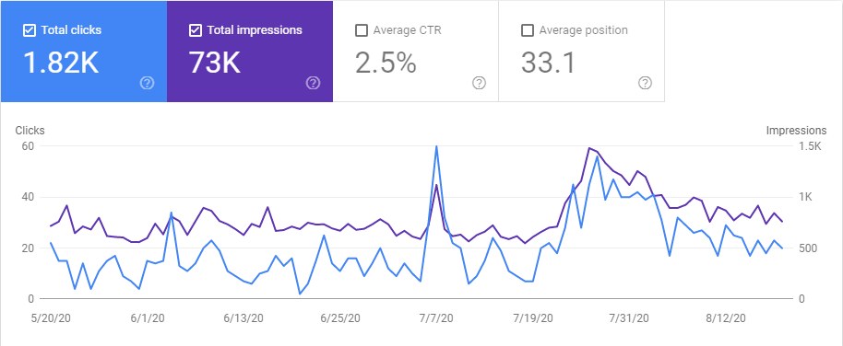
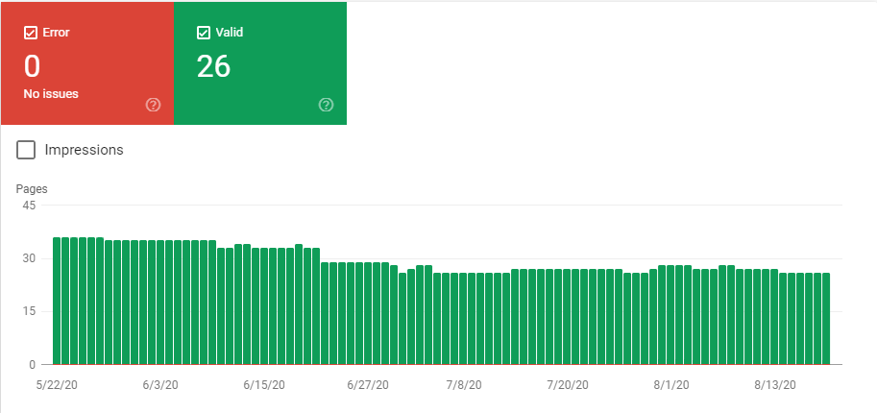
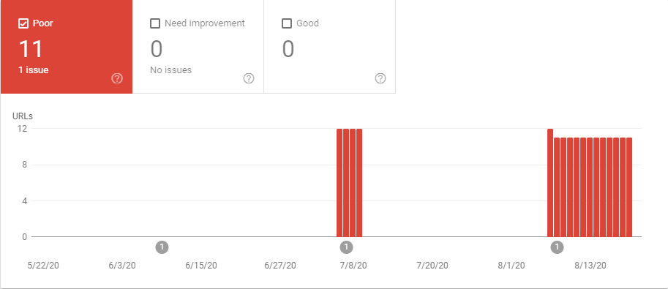
Google Search Console
Performance is OK
Coverage is OK
Sitemaps are OK
No security issues
Mobile usability OK
Core Web Vitals – WHAT?
  “LCP issue: longer than 4s (mobile)”

Slide 17
Google PageSpeed vs Lighthouse
PageSpeed Insights
  https://developers.google.com/speed/pagespeed/insights/
  Measures the “Performance Metric” only
  Uses a “combo” of lab and real-world data
  Uses the Lighthouse “integrated analysis engine”
Lighthouse
  “Uses lab data only (under consistent conditions)”

Slide 18
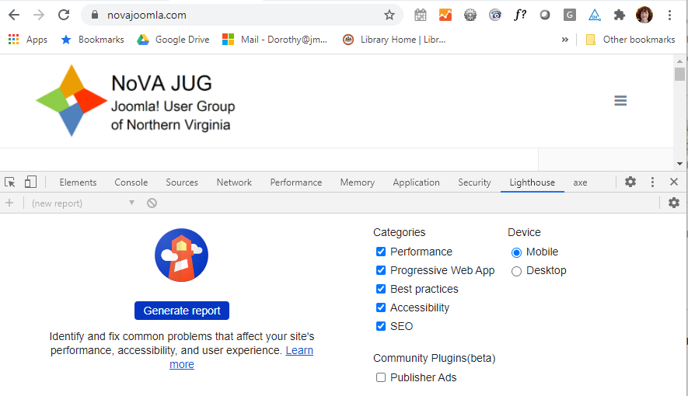
Using Lighthouse via Chrome
More tools → Developer Tools → Lighthouse tab
Or just press F12

Slide 19
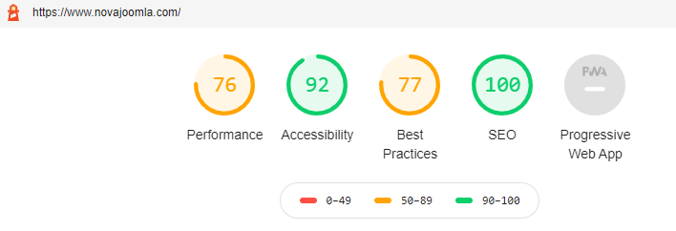
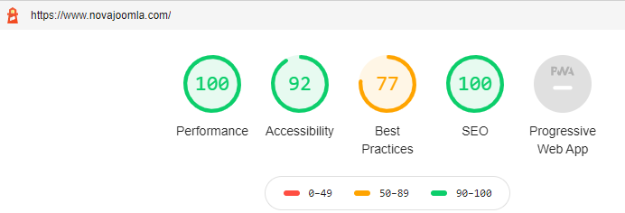
Look at both Mobile and Desktop
Mobile is the default / worse performance
  Mobile:
  Desktop:

Slide 20
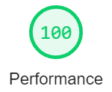
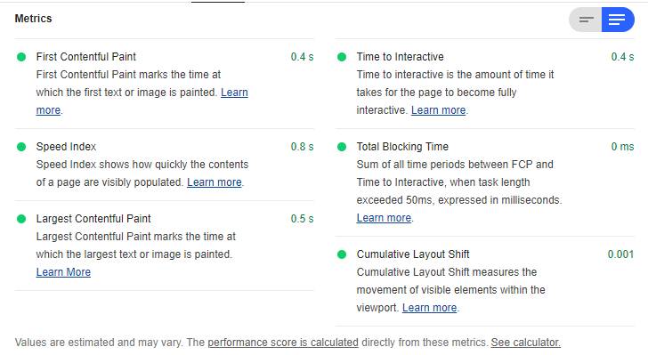
Performance Measures
Blue selector / read more for explanations
Novajoomla on DESKTOP:

Slide 21
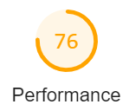
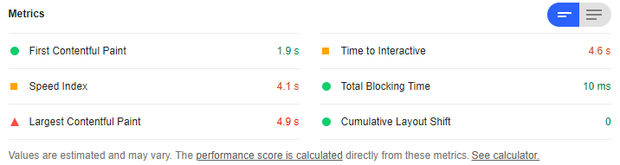
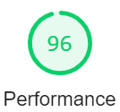
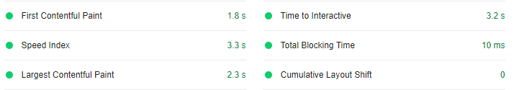
Performance Measures
Blue selector / read more for explanations
Novajoomla on MOBILE:
With a few fixes, I got it up to 96:

Slide 22
PageSpeed Insights vs Lighthouse
Sometimes HUGELY different results.
  https://github.com/GoogleChrome/lighthouse/issues/6708
  “It's a highly useful tool, but it should be used with a grain of salt.”
  “PSI web never reports the same score twice, even for the same page”
  “The two scores differ (lighthouse vs web), even though they are based upon the exact same source code (geographic location, network speed, latency, and cpu power differ)”
  “If you run Lighthouse on a slower cpu speed pc, and on a more powerful one, the score change is massive and it reports problems with completely different aspects of the page”
“In the real world, SEO companies use PSI. LH not to be taken seriously. All devs proudly showing scores on Twitter are basically proud of having fast hardware.”
It has been suggested to click “clear all”: this icon:
Also different scores from LH available through mysites.com

Slide 23
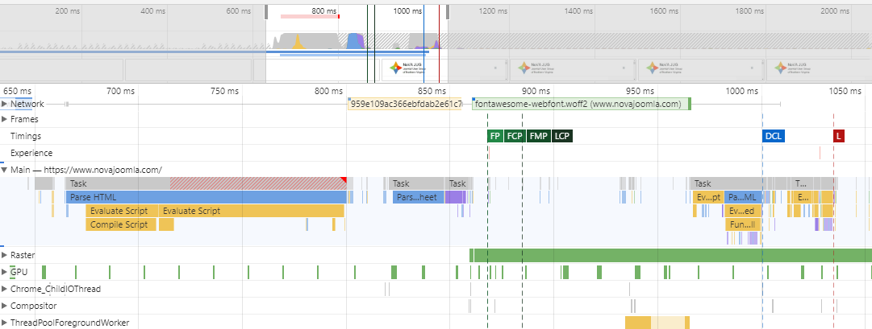
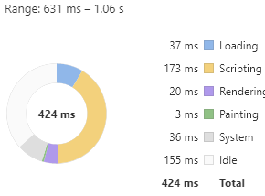
Click “View Trace”
FCP = First Contentful Paint
Gets complicated…
Back to Lighthouse!

Slide 24
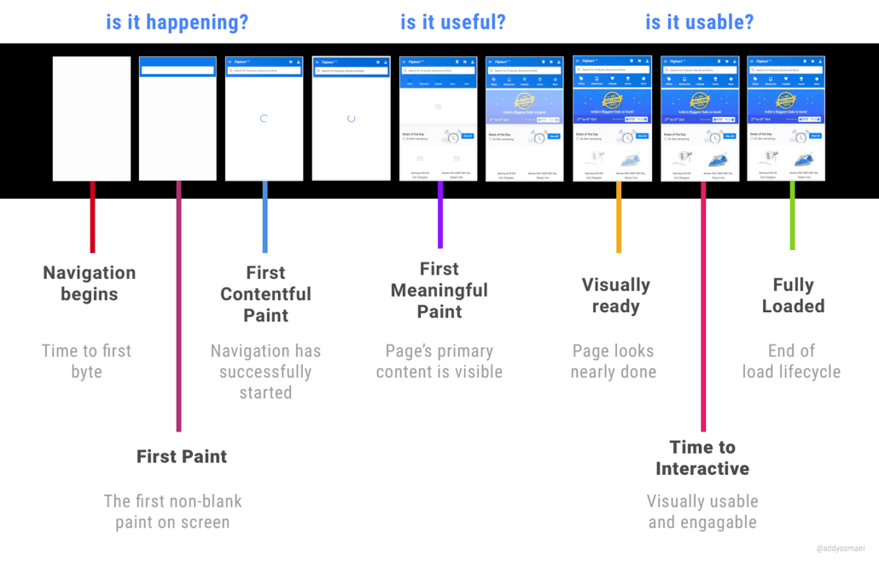
Page load on Mobile
From: https://suncityadvising.com/wp-content/uploads/2018/06/Page-Load-Pagespeed-performance-1030x659.png

Slide 25
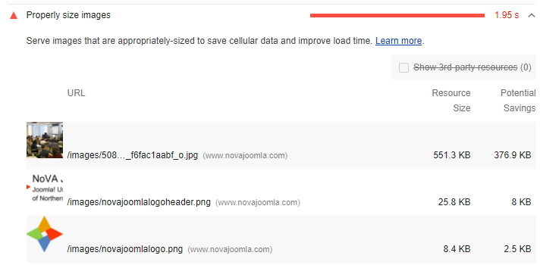
Performance Recommendations
Properly size images
Joomladay – Fixed, but it says it can be smaller still
From Meetup
Logo – Fixed

Slide 26
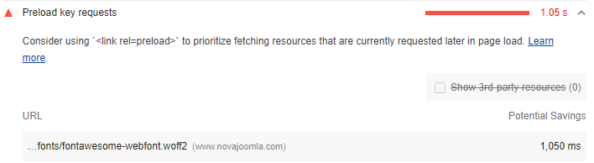
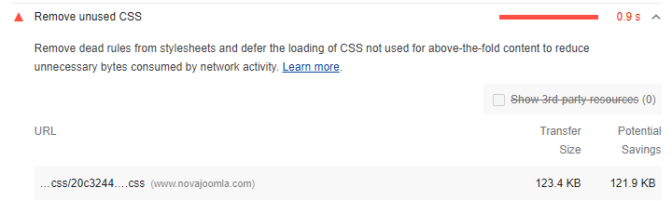
Performance Recommendations
Preload key requests
Remove unused CSS

Slide 27
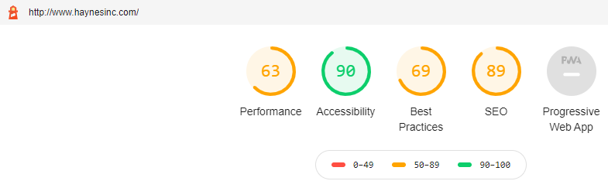
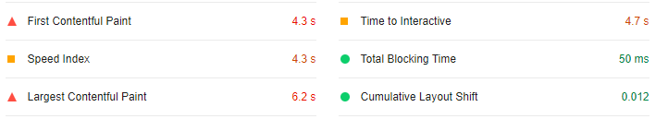
This site has lower performance
Let’s review recommendations

Slide 28
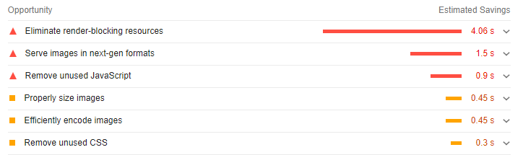
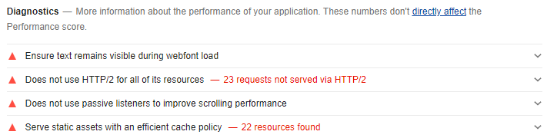
Performance - Opportunities

Slide 29
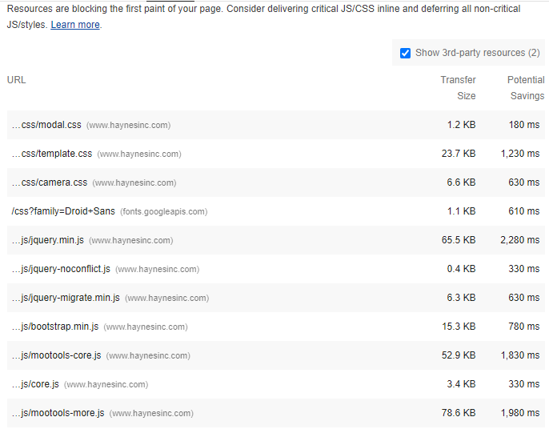
Performance (1)
Eliminate Render-blocking resources
Gobs of css and js files here
Also Google fonts
Typically a template issue
Template may offer tools to combine, minify, defer the css and js
If not, extensions exist, e.g., JCH Optimize

Slide 30
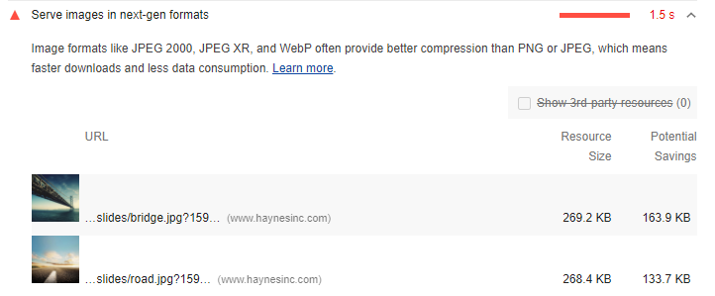
Performance (2)
Serve Images in Next-Gen Formats
How do we do that, and is it advisable?

Slide 31
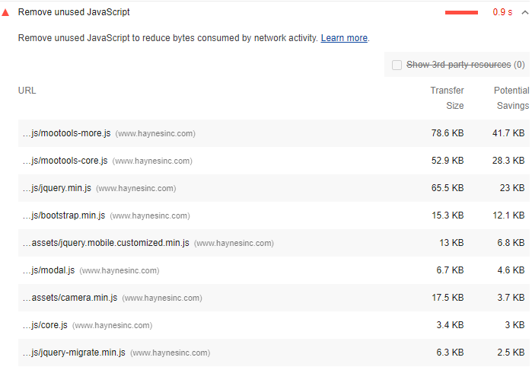
Performance (3)
Remove unused Javascript
Hard to do this if part of a template
If it is part of an unused extension, uninstall it!

Slide 32
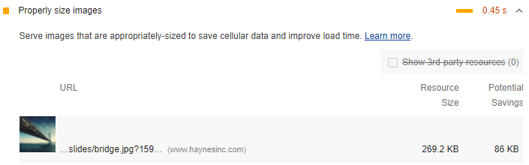
Performance (4)
Properly Size Images
  This will catch oversized images – resize them, don’t resize in browser
  But serving multiple image sizes for mobile and desktop = more challenging

Slide 33
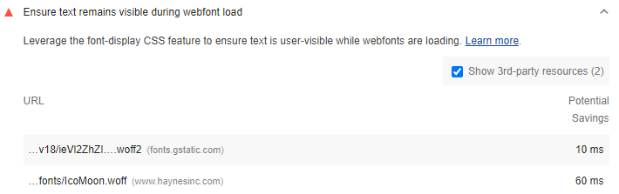
Performance (5)
Ensure text remains visible during webfont load
Again, often a template issue
Preload web fonts #
Use <link rel="preload"> to fetch your font files earlier.
Add the &display=swap parameter to the end of your Google Fonts URL:
<link href="https://fonts.googleapis.com/css?family=Roboto:400,700&display=swap" rel="stylesheet">

Slide 34
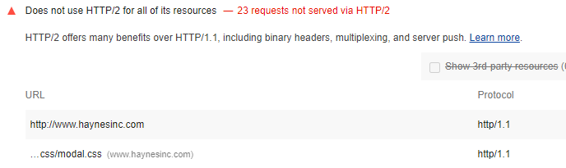
Performance (6)
Does not use HTTP/2 for all of its resources
Typically a server / site hosting consideration
Must be enabled on the server

Slide 35
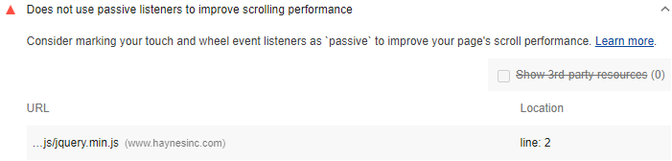
Performance (7)
Does not use passive listeners to improve scrolling performance
Supposedly works in most browsers
https://developer.mozilla.org/en-US/docs/Web/API/EventTarget/addEventListener#Browser_compatibility

Slide 36
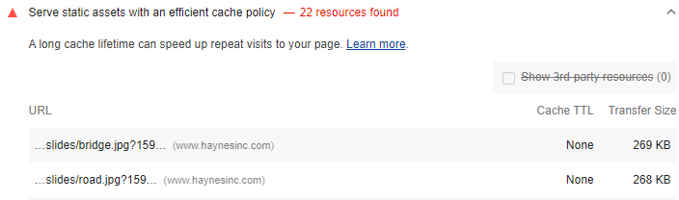
Performance (8)
Serve static assets with an efficient cache policy
Can be done in .htaccess
Admintools offers an option

Slide 37
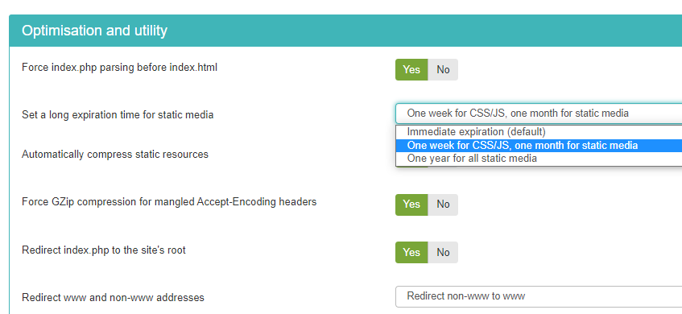
Performance: Admintools Pro
Set long expiration for static resources
Automatically compress static resources

Slide 38
Performance: Joomla Topics
Gzip compression
Caching – a whole topic unto itself
Lightweight templates
Template performance tools
JCH Optimize or other performance tools
CDNs, faster hosts

Slide 39
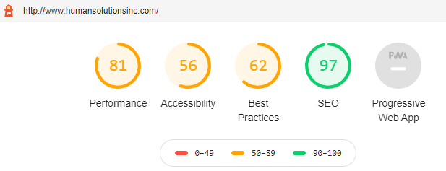
Accessibility: Many Checks
This one could use some help:

Slide 40
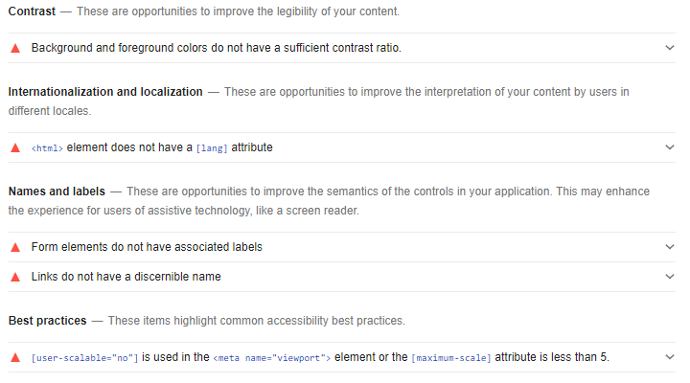
Accessibility
Only a subset of accessibility issues can be tested

Slide 41
Accessibility Examples
Background and foreground colors do not have a sufficient contrast ratio
Form elements do not have associated labels
Disabling zooming is bad
Images should have alt tags
Heading elements not in sequentially-descending order
Video elements should have captions and descriptions
Links without a discernable name – e.g., nothing, “click here”, etc.
Tap targets are too small – need to be 48px x 48px or larger
Tips are given for manual review of other aspects

Slide 42
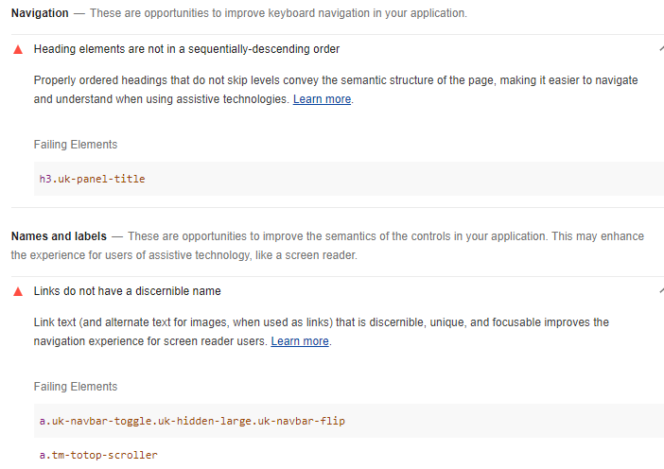
Accessibility - Novajoomla
Uhh, these are part of the template

Slide 43
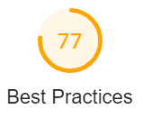
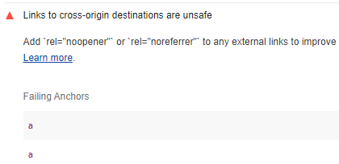
Best Practices
Novajoomla site:
Links to cross-origin destinations are unsafe
  Linking to a page on another site using the target="_blank" attribute, you can expose your site to performance and security issues
  The other page may run on the same process as your page. If the other page is running a lot of JavaScript, your page's performance may suffer
  The other page can access your window object with the window.opener property. This may allow the other page to redirect your page to a malicious URL. Adding rel="noopener" or rel="noreferrer" to your target="_blank" links avoids these issues.
These turned out to be inside JoomlaWorks “Simple RSS Feed Reader”
Click thru from Lighthouse to Elements

Slide 44
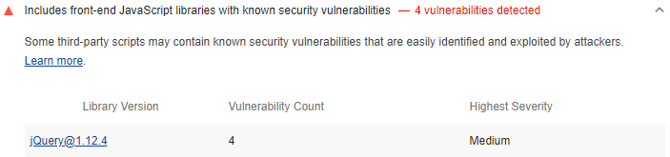
Best Practices
Novajoomla site:
Includes front-end JavaScript libraries with known security vulnerabilities

Slide 45
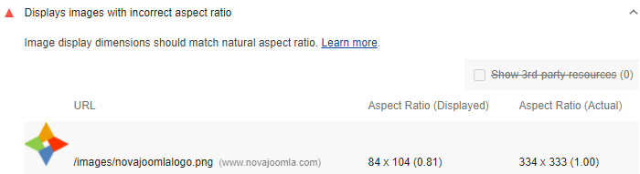

Best Practices
Novajoomla site:
Displays images with incorrect aspect ratio
But:
Was resized to 84 x 84
Exported new image as 84 x 84

Slide 46
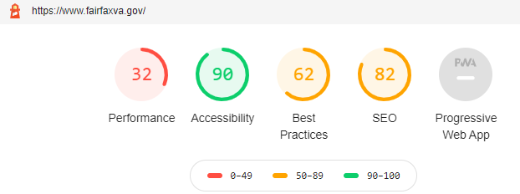

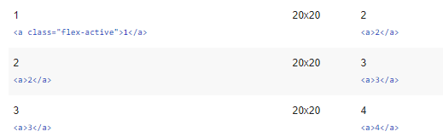
SEO examples
Document does not have a meta description
Links do not have descriptive text
Image elements do not have alt tags
Tap targets are not sized appropriately
Should be 48px x 48px

Slide 47
Overall….
It’s worth running on your sites
The recommendations will help you tune up your sites
Not sure about the validity of the performance scores – read more about it!

Slide 48
Joomla! Tidbits…

Slide 49
May Tidbit – Akeeba Backup
Change backup outside of default location for increased security
Putting it outside of public_html is best

Slide 50
March Tidbit: Can’t get into 2fa
If you can log in – simply go to Extensions → Plugin, search for Two Factor Authentication and disable it.
  Or use your saved list of recovery codes. You have that, right?
If you can’t do that:
  Log into phpMyAdmin in CPANEL or otherwise
  Select the database for your website
  Go to the extensions table and set enabled to 0 for plg_twofactorauth_totp
  Also set plg_twofactorauth_yubikey to 0 if you are using Yubikey
  Alternatively: assuming your database table prefix is AAA___, run the following queries:
    UPDATE `AAA__extensions` SET `enabled` = '0' WHERE `name` = 'plg_twofactorauth_totp';
    UPDATE `AAA__extensions` SET `enabled` = '0' WHERE `name` = 'plg_twofactorauth_yubikey’;
TIP: if you have multiple sites on a given domain, you will need to make different recognizable usernames, to keep the codes separate

Slide 51
February Tidbit: Embed Code Gone
Iframe and embed code from a page when a user without sufficient authorization saves it – maybe just leaving some empty paragraph tags or even &nbsp;
Options to consider:
TinyMCE:
  Go to extensions > plugins > editor and find TinyMCE plugin
  Remove iframe from list of prohibited elements for the selected panel set and add it to “Extended valid elements” list
JCE:
  Go to profiles and find the right profile for the user
  Change settings in Media to set Allow Iframes to Yes
  Or just use Code view and save; don’t look at the wysiwyg view at all
Don’t use an editor → Set it to Editor-None
Global configuration:
  Change setting for Text Filter Setting for the given user group → No Filtering, or whitelist / blacklist per the next page

Slide 52
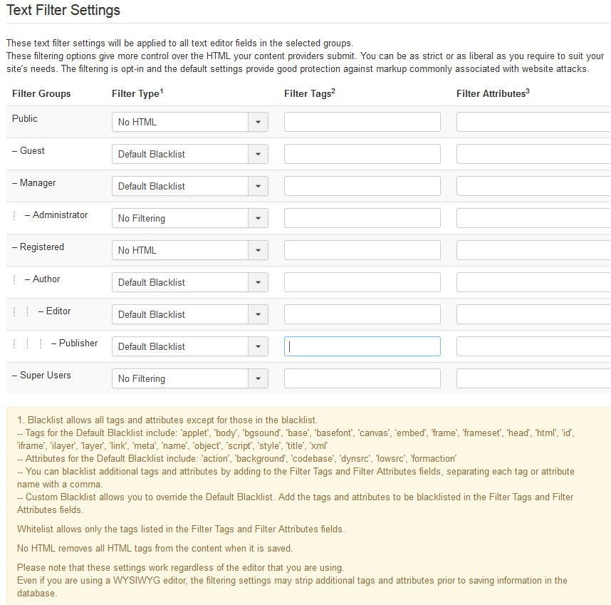
Text Filter
Settings
Tweak per the footnotes

Slide 53
November Tidbits: Backend Notices and Notifications
There is a new version of Joomla! out, but your website doesn’t say so.
  Go to Plugins and search for update
  Update notification → turn on to get emails
  Update icon → turn on to have the message and link in the control panel
  Check also that Update Source in the Update Channel is set to Default
You can also set it to tell people when a backup is needed
  Useful if other people are adding content to the site.

Slide 54
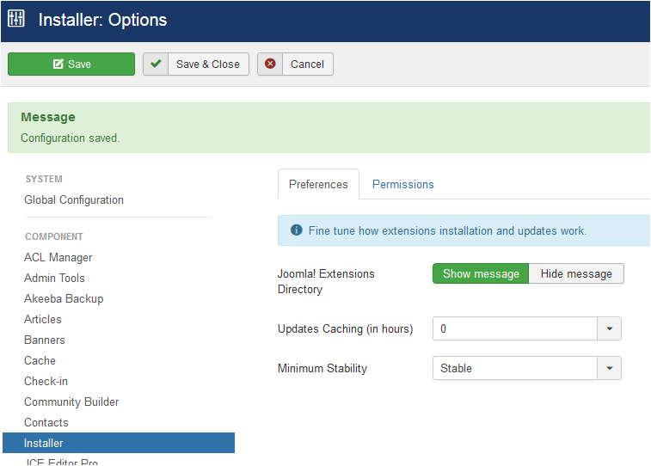
November Tidbits (2):
IF you get way too many email notifications for a site:
  Go to Installer / Preferences
  Change Updates Caching (in hours) to something not zero. E.g., change it to 6 hours.

Slide 55
October Tidbit:Ospam-a-not
OSPam-a-not extension from Joomlashack
  Uses a time gate – no reCaptcha
    Hidden timestamp that records how log it took to fill out a form
    Blocks bots
    No additional setup after install – enable recording of spam attempts and set a minimum form time in case form submissions are blocked too quickly
I have not tried this / not sure whether it works on logins as well.

Slide 56
September Tidbits
Could not upload pdf files any more!
  Had upgraded PHP on site
  Joomla! was already set to allow pdfs
  Was able to bypass processing them and let it work
  Still a PHP library issue to be researched
  Anybody know more about how this works?
JCE issue on editing 2nd textarea in Zoo
  Could not add a link or use other functions
  Tested with various JCE profiles and settings
  But could use TinyMCE so it was a JCE issue
  Contacted JCE, they issued a patch
  It now works with the latest updates

Slide 57
August Tidbits
Issue with Joomlart template’s MegaMenu + AdminTools
  MegaMenu takes over normal Joomla menu module functions, e.g., which levels to display
  Suddenly, would not allow adjustment of main menu as needed on a running site
  Turned out to be in conflict with Akeeba Admintools
  Fixed with setting Admintools to “Allow Site Templates”

