Slide 1
Akeeba Admintools and LoginGuard
Northern Virginia Joomla Users Group
June 2020
Dorothy Firsching, Ursa Major Consulting, LLC
dfirsching@ursamajorconsulting.com

Slide 2
Agenda
Joomla! Updates
Upcoming JUG Meetings
Program – Akeeba Admin Tools
Additional Topics?
  Lynn Kirby – OS properties – would be happy to give a review
Topics for Future - Discussion

Slide 3
Akeeba Admin Tools
Software Security Component
  Tightens security – GREAT, GREAT, GREAT, stops a ton of bots and bad actors
  Improves administration
  Does not touch Joomla! Core files
Core (free) and Pro (subscription)
  Core has basic features
  Security features are in Pro version – 50 Euros / year for unlimited sites
Nicholas K. Dionysopoulos
  Developer of Akeeba Backup
  Outstanding developer / best practices
  Much of his work has wound up in Joomla itself over the years

Slide 4
Selected Features (both Core and Pro)
Administrator Directory Protection
  Add a password to administrator directory
  Annoying to backend users but much more secure
Review and fix file and folder permissions
  This has been really helpful in catching and fixing extensions that oops – leave a 777 somewhere!
Repair and optimize database tables
  This has been really helpful when the site is down due to a database issue
One-click purge of temporary directory
Purge and optimize sessions

Slide 5
Selected Pro Security Features (1)
PHP File Change Scanner
Protect against common file injection attacks
Protect against SQL injection attacks
Block cross site scripting
Uploads scanner
Disable PHP Easter Eggs
Disable directory listings
Block security-sensitive files (e.g., php.ini)
Block user-specific agents
Schedule cleanup of temporary directory and sessions table
Emergency Off-Line Switch

Slide 6
Selected Pro Security Features (2)
Logging of security exceptions
Auto-ban IPs causing excessive security exceptions
Email notification of security exceptions, admin logins
Forbid / monitor front-end super admin login, super-admin creation, editing user credentials
IP deny list
Administrator IP exclusive allow list
Admin secret URL parameter
Block access to Joomla! Extensions installer
Block template=foo, tmpl=foo template switch
Project Honeypot integration

Slide 7
Selected Pro SEO Features
Redirect old URLs or make URL shortener
Optimize expiration time
Compress static resources
  Images, css, js
Redirect index.php to site root
Redirect www / non-www
Redirect old domain name to new domain
Force HTTPS for specific URLs even when Joomla doesn’t let you
Force HSTS header

Slide 8
Demo –Admin Tools Pro (1)
URL parameter
  Without it – nobody sees the login page
Set Offline
  Locks out everybody other than from my current IP until I put it back online
Master Password
  Keep other users / admins from messing with Admin Tools settings
  You can adjust which features to protect or ALL
  If you lose it, you can read it from the database
Password Protect Administrator
  Puts username and password on admin folder, using Apache .htaccess and .htpasswd files --- so not on IIS servers
  NOTE: watch out if moving a site to IIS
  Can unprotect just as easily beforehand

Slide 9
Demo – Admin Tools Pro .htaccess maker
.htaccess Maker – hugely useful
  https://www.akeebabackup.com/documentation/admin-tools/htaccess-maker.html
  Defaults are a good start – protects from a lot of malicious things
  It DOES rename the current .htaccess so you can go back in and restore it if it does not work OK
  But CHECK that the site is working!
  Usually you need to customize “Allow direct access, including .php files, to these directories” to include certain template folders and to mysites or similar, but allow other folders to be blocked
  You need to adjust Base directory of the site if not in root
  Probably want to use it to set a long expiration for static resources
    It hard codes expiration dates based on Google and Yahoo performance recommendations
  Probably want to compress static resources and Force Gzip for mangled Accept-Encoding headers
    Speeds up the site
  You may want to use it to redirect an old domain name to a new one IF they are in the same hosting account. (If on a different hosting account, create a .htaccess in the old account to point to the new one with a 301 redirect.)

Slide 10
Demo – Admin Tools Web Application Firewall
Blocked requests log == Exception log
Configure WAF
  Basic Features
    Secret URL parameter
    Defend against plugin deactivation
  Hardening Options – things to monitor and email you
  Cloaking
  Auto-Ban = block those bots, but users who forget their password can get blocked
  Exceptions – Never block certain Ips
  Logging and reporting

Slide 11
Admin Tools Other Goodies
PHP File Change Scanner
Fix Permissions
Temporary Super Users
Link Migration
  https://www.akeebabackup.com/documentation/admin-tools/ch02s12.html
Clean Temp Directory
Repair and Optimize Tables
  Can also do this in PhpMyAdmin but this is easier – sometimes fixes hangs
Purge Sessions just optimizes the sessions table, will log you out but also fixes issues
URL Redirection – can make URL shorteners of external URLs

Slide 12
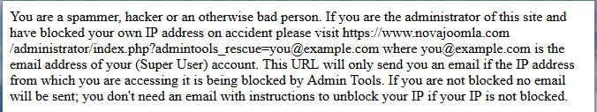
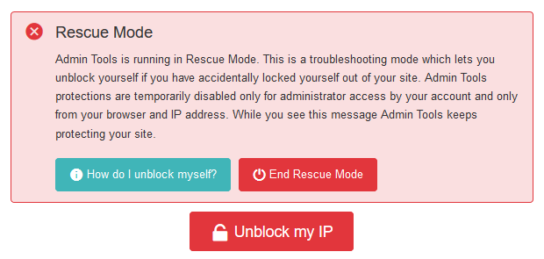
Now you’re locked out…
Two ways to get back in:
  Rescue URL
  FTP
    Go to plugins/system/admintools/admintools and rename main.php to main-bak.php or similar, then rename after unblocking your IP
AVOID leaving login page sitting in your browser!

Slide 13
Your site isn’t working…
JoomlArt’s MegaMenu or other parts won’t work in backend
  Site works, just you can’t change it…
  Admintools is blocking access to a folder it needs
Site’s CSS isn’t showing
  JoomlArt’s CSS folder is blocked
Forms not working
  Perhaps spambot blocking is working too well
  Look at referrer in the security exceptions log to see if it is an attack or you see false positives
  Turn off CSRF Shield or tone it down to “Basic” rather than “Advanced”
Other extensions or templates could need a particular folder available
  Go to your Browser’s Developer Tools and see what the problem is

Slide 14
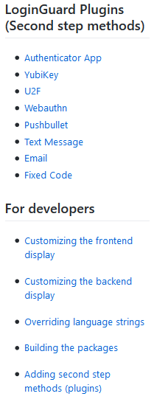
Akeeba LoginGuard (Separate Extension, not part of Admin Tools)
https://github.com/akeeba/loginguard/wiki
Changes action of Joomla’s 2 factor authentication
  You avoid the “Secret Key” field that confuses users
  Takes you to “captive” login page
  Can easily configure which groups use each verification method – e.g., non-password methods
  Supports methods requiring user interaction – know which user is being authenticated to send a SMS code, etc.
  Free

Slide 15
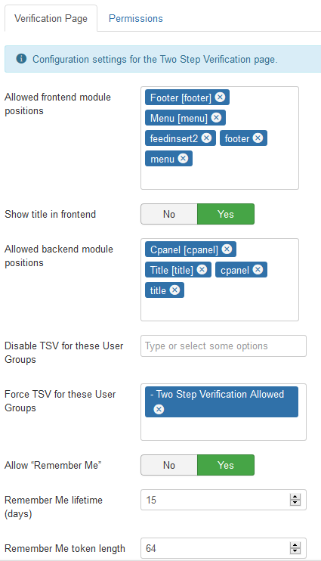
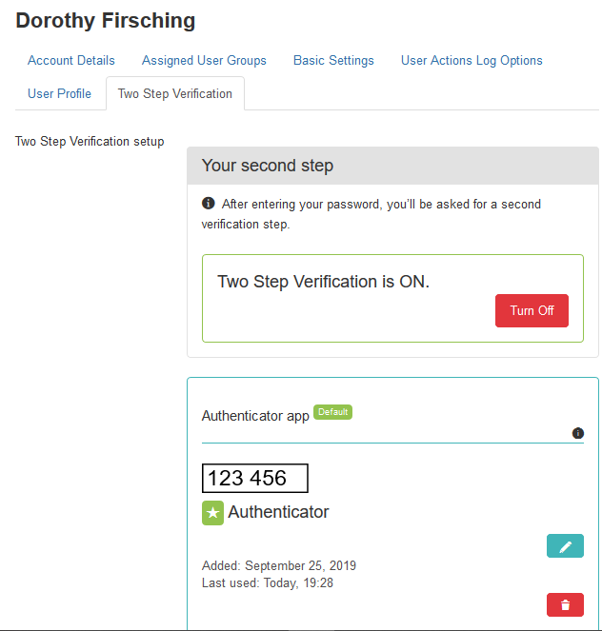
Akeeba LoginGuard

