Slide 1
Joomla! Updates and Tips
Northern Virginia Joomla Users Group
September 2020
Dorothy Firsching, Ursa Major Consulting, LLC
dfirsching@ursamajorconsulting.com

Slide 2
Agenda
Joomla! Updates
Upcoming JUG Meetings
Program – Marvin on Gantry and SASS
Topics for Future - Discussion

Slide 3
Latest Joomla! Updates
3.9.22 – 88% done
3.9.21 – August 25, 2020
Joomla 4 Beta 4 – September 15, 2020
  Over 100 bugs squashed
3.10 Alpha 2 – September 15, 2020

Slide 4
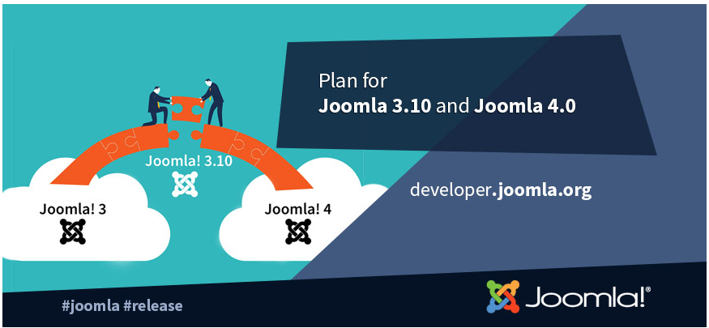
Upcoming
Joomla! Releases
Joomla! 3.10 – last of Joomla! 3.x Series – ?? 2020
  API changes prior to Joomla! 4.0
  Will be supported for 2 years after release
  Update Checker – test compatibility with Joomla! 4.0
  https://magazine.joomla.org/all-issues/may-2020/joomla-3-10-and-the-update-checker
Joomla! 4.0 beta 4 – September 15, 2020
  https://magazine.joomla.org/all-issues/may-2020/the-may-issue
  Can update to Joomla! 3.10 and then to 4.0 beta
  I installed Joomla! 4.0 beta 3 but site templates won’t work with it yet

Slide 5
Joomla! 4.0 Key Features
https://magazine.joomla.org/all-issues/may-2020/joomla-4-what-to-expect
Workflow
Media Manager
Installation – in seconds
A cleaner and more powerful codebase. With the removal of deprecated functions from Joomla 3.x and the use of PHP namespaces that allows developers to deliver more robust and innovative applications than ever before
The web is for all. We aim to ensure that the templates are accessible (Level AA of WCAG 2.1)
The power of the Joomla Framework merged into the CMS
A fully rebuilt Media Manager with a cleaner User Interface and new image editing capabilities
A new Publishing Workflow to manage your articles in an advanced and customisable way
New security features such as support for prepared SQL statements
Web Services to allow you to make your content accessible to other websites
An enhanced event dispatching system
HTML Mail Templates to allow easy customisation of the emails your site sends
An improved and expanded Command Line Interface (CLI)
Clean codebase, high coding quality, but many changes.

Slide 6
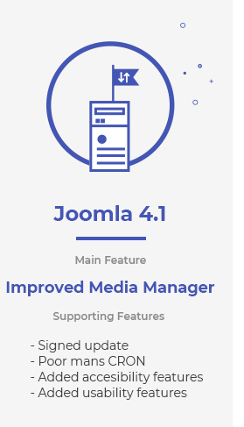
Joomla 4.1 Features
6 months after 4.0
Even more improved
Media Manager
Signed Updates
CRON
Accessibility features
Usability Features
https://joomlachicagonorth.com/blog/the-day-after-joomla-4-0-planning-the-future

Slide 7
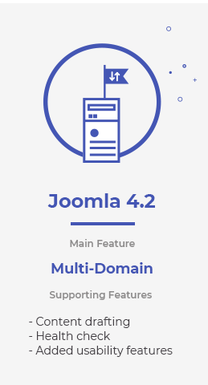
Joomla 4.2 Features
Multi-Domain
Content Drafting
Health Check
Usability
If you want to help:
https://volunteers.joomla.org/teams/joomla-enhancement-development-team

Slide 8
Joomla! 4 compatibility
Don’t forget that Joomla! 3.10.x will be supported for 2+ years after it is released
Joomla 4 will have a new, standard way of handling license keys:
  https://watchful.net/blog/joomla-4-license-key/
Extensions
  Akeeba Backup: Will start working on J4 after beta is released. “J3 to J4 is a FAR bigger leap than J2.5 to J3.”
  JomSocial: Built for Joomla! 1.5, upgraded. Needs to change for Joomla! 4. Plans are to support both 3.x and 4.
Templates
  JoomlArt: T4 will work for J3 and J4; will roll out templates for J4 as soon as J4 goes stable.
  Rockettheme: Gantry 4 will not be rewritten for Joomla! 4. Working on bringing most popular templates to Gantry 5, which will work with Joomla 4.

Slide 9
Updating Joomla 4
Go to System / Joomla
Click Options
  For Minimum Stability, select Beta
  For Update Channel, choose Custom URL and paste in: https://update.joomla.org/core/nightlies/next_major_list.xml.
  Save and Close
Go to Live Update / Click Install the Update

Slide 10
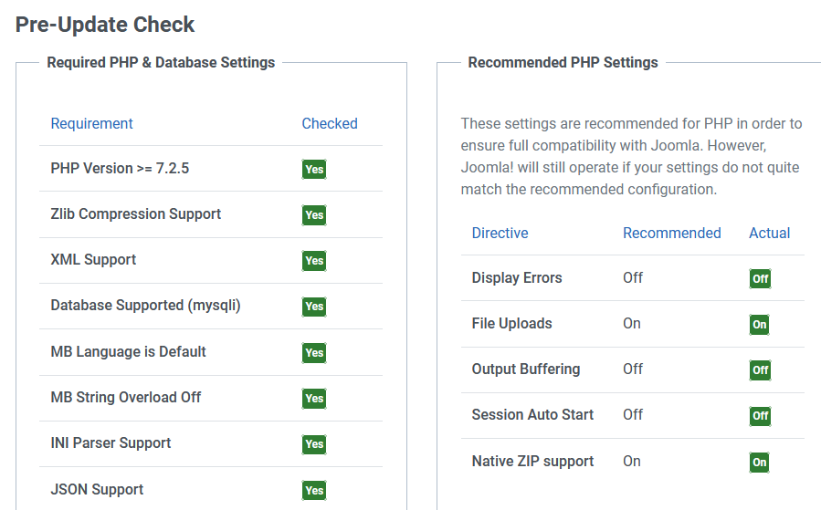
Pre-Update Check

Slide 11
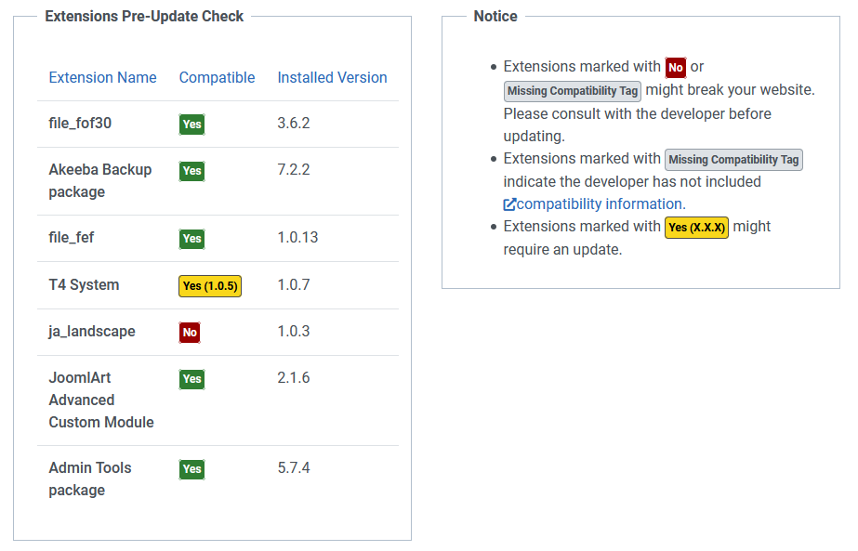
Extensions Pre-Update Check
I had already figured out that the Ja_landscape template was broken; though it said it was Joomla 4 ready!

Slide 12
Other Joomla! Events
Joomla Users Group of NJ - https://joomlausersnj.com/
  New Brunswick, NJ
JUG Chicago North (JUGCN) https://joomlachicagonorth.com/
  August 26,2020 – Custom Fields and External Data Sources, 2 pm our time, https://joomlachicagonorth.com/meetings/event/133-custom-fields-and-external-data-sources
  October 17, 2020: JoomlaDay Chicago
  Squash bugs weekly for J4!
Joomla User Group Boston
  https://www.jugboston.org/meetings/event/3-keyword-research-how-it-supports-seo-as-well-as-overall-marketing-strategy -- Was in August, may have been recorded
Joomla! Users Group Long Island
  Meets monthly but no info…

Slide 13
Upcoming NOVA JUG Events
Monday, September 28, 2020
Monday, October 26, 2020
Monday, November 23, 2020
Monday, December 28, 2020
Cancel for holidays? Reschedule?
Topics / Speakers?

Slide 14
Joomla! Tidbits…

Slide 15
May Tidbit – Akeeba Backup
Change backup outside of default location for increased security
Putting it outside of public_html is best

Slide 16
March Tidbit: Can’t get into 2fa
If you can log in – simply go to Extensions → Plugin, search for Two Factor Authentication and disable it.
  Or use your saved list of recovery codes. You have that, right?
If you can’t do that:
  Log into phpMyAdmin in CPANEL or otherwise
  Select the database for your website
  Go to the extensions table and set enabled to 0 for plg_twofactorauth_totp
  Also set plg_twofactorauth_yubikey to 0 if you are using Yubikey
  Alternatively: assuming your database table prefix is AAA___, run the following queries:
    UPDATE `AAA__extensions` SET `enabled` = '0' WHERE `name` = 'plg_twofactorauth_totp';
    UPDATE `AAA__extensions` SET `enabled` = '0' WHERE `name` = 'plg_twofactorauth_yubikey’;
TIP: if you have multiple sites on a given domain, you will need to make different recognizable usernames, to keep the codes separate

Slide 17
February Tidbit: Embed Code Gone
Iframe and embed code from a page when a user without sufficient authorization saves it – maybe just leaving some empty paragraph tags or even &nbsp;
Options to consider:
TinyMCE:
  Go to extensions > plugins > editor and find TinyMCE plugin
  Remove iframe from list of prohibited elements for the selected panel set and add it to “Extended valid elements” list
JCE:
  Go to profiles and find the right profile for the user
  Change settings in Media to set Allow Iframes to Yes
  Or just use Code view and save; don’t look at the wysiwyg view at all
Don’t use an editor → Set it to Editor-None
Global configuration:
  Change setting for Text Filter Setting for the given user group → No Filtering, or whitelist / blacklist per the next page

Slide 18
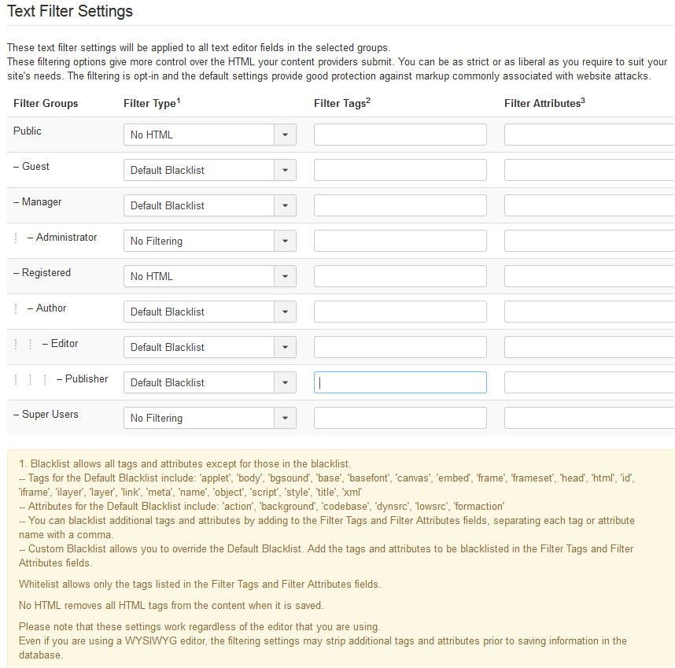
Text Filter
Settings
Tweak per the footnotes

Slide 19
November Tidbits: Backend Notices and Notifications
There is a new version of Joomla! out, but your website doesn’t say so.
  Go to Plugins and search for update
  Update notification → turn on to get emails
  Update icon → turn on to have the message and link in the control panel
  Check also that Update Source in the Update Channel is set to Default
You can also set it to tell people when a backup is needed
  Useful if other people are adding content to the site.

Slide 20
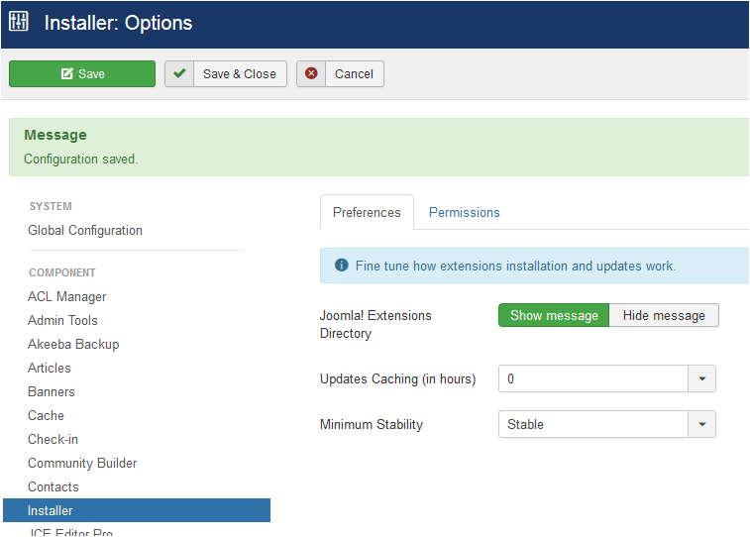
November Tidbits (2):
IF you get way too many email notifications for a site:
  Go to Installer / Preferences
  Change Updates Caching (in hours) to something not zero. E.g., change it to 6 hours.

Slide 21
October Tidbit:Ospam-a-not
OSPam-a-not extension from Joomlashack
  Uses a time gate – no reCaptcha
    Hidden timestamp that records how log it took to fill out a form
    Blocks bots
    No additional setup after install – enable recording of spam attempts and set a minimum form time in case form submissions are blocked too quickly
I have not tried this / not sure whether it works on logins as well.

Slide 22
September Tidbits
Could not upload pdf files any more!
  Had upgraded PHP on site
  Joomla! was already set to allow pdfs
  Was able to bypass processing them and let it work
  Still a PHP library issue to be researched
  Anybody know more about how this works?
JCE issue on editing 2nd textarea in Zoo
  Could not add a link or use other functions
  Tested with various JCE profiles and settings
  But could use TinyMCE so it was a JCE issue
  Contacted JCE, they issued a patch
  It now works with the latest updates

Slide 23
August Tidbits
Issue with Joomlart template’s MegaMenu + AdminTools
  MegaMenu takes over normal Joomla menu module functions, e.g., which levels to display
  Suddenly, would not allow adjustment of main menu as needed on a running site
  Turned out to be in conflict with Akeeba Admintools
  Fixed with setting Admintools to “Allow Site Templates”

