Slide 1
Joomla! Forms Extensions
Northern Virginia Joomla Users Group
July 23, 2018
Dorothy Firsching, Ursa Major Consulting, LLC
dfirsching@ursamajorconsulting.com

Slide 2
Agenda
Joomla! News and Plans
Joomla! Updates
Our JUG
Forms Extensions

Slide 3
Joomla! 3.8.9/10 News
3.8.9 fixed 2 low priority security vulnerabilities and several bugs, including the fatal error in the random image module
3.8.10 fixed one bug which affects Windows Servers, so be sure to go right to 3.8.10

Slide 4
Joomla! 3.9 and 3.11
Joomla 3.9: Privacy Features for GDPR (led by Michael Babker)
The General Data Protection Regulation (GDPR) entered into force on 25 May, 2018.
Joomla 3.11: Last release of 3.x series (led by George Wilson) – 100% complete, due 7/31/2018
Will be released along with Joomla! 4.0, to ease the transition. Primarily API changes.

Slide 5
Joomla! 4.0
Alpha 3 is released
3 more main features for Beta release 1
Backend Template Redesign – 70% done
Extension services – improved setup of extensions – 95% done
Prepared Statements – 10% done
Separates query from content so that hacker can’t modify the query itself
https://magazine.joomla.org/item/3331-secure-all-the-things-joomla-security-team-sprint-cologne-may-2018
Note that Joomla! 4.0 will require php 7

Slide 6
Upcoming NoVA JUG events
Current room reservations: Thursdays were not available
Monday, July 23, 2018: Kings Park Library
Monday, August 13, 2018: Kings Park Library
Monday, September 10, 2018: Kings Park Library
Monday, October 15, 2018: Kings Park Library (once again, could not get Monday, Oct. 8 or Thursday)
What day of the week is best?
What locations?
Decide and we will update Meetup!

Slide 7
Other Upcoming Joomla Events
JoomlaCamp Chicago
September 22, 2018
CMS Summit / Merge
September 14-16, 2018
Lake Buena Vista, FL
JoomlaDay Brasil 2018
August 10-12, 2018
JoomlaDay Austria 2009
March 29-30, 2019
Vienna, Austria
Many more… work is in process for JUG events to be pulled into a common event resource!
https://community.joomla.org/events/joomladays.html

Slide 8
Joomla! Forms Extensions with a focus on RS Forms pro

Slide 9
What do you want from Forms?
Simple contact forms → Contacts Tools
Emails from form submissions
More complex forms → Forms Tools
Complex, multipage forms with decision logic
Stored data you can access
Email attachments (e.g., resumes)
Special-purpose forms → Forms Plus
Event registrations
Directory Updates or other data editable by users
Documents (e.g., resumes)
E-Commerce

Slide 10
Contact Forms
No Form at all
Just make a contact page and provide address, phone number, email address, etc.
Joomla! built-in Contacts component
Now has a few more options than before, but fields and styling used to be quite limited
You will want to add a captcha – e.g., Recaptcha v2
Receive emails without revealing the email address to bots
Joomla! Contacts extension you select and install
See the Joomla! Extensions Directory and search for contact forms
Many are free, e.g., RSContact, FlexiContact
Any Joomla! Forms Component
More flexibility
Receive emails, but perhaps send multiple emails to different people or save the information in the database

Slide 11
Forms Tools (1)
RSForm!Pro – I’ve used extensively
Multiple types of fields and validations
Multiple responsive layouts
Unlimited Emails
Captcha / Recaptcha
Conditional Fields, calculations
Can customize with css, js, code
Store data in database, easy to export to multiple formats
As form page, embed in module or article
Handles most of your “forms” needs
$20 for a single website, $100 for unlimited websites for one year of support
https://extensions.joomla.org/extension/rsform-pro/
Plugins for Authorize.net, SMS notification, etc. ($)

Slide 12
Forms Tools (2)
Shack Forms – Joomlashack
Probably good, have not used
Multiple types of fields
Integration with Acymailing, MailChimp, etc.
Email attachments
$29 for 6 months, $39 for 12 months, probably for unlimited sites
https://extensions.joomla.org/extension/shack-forms/

Slide 13
Forms Tools (3) Chronoforms
Free Version and Paid Full Version (used to be free, except to remove their tagline); reviews say it’s the most flexible
Now supported as V6, V5, and v4 (been around for 10 years)
I used to use it a lot, through v5
Can do many kinds of fields and validations
Can do complex multipage forms with logic, customizable
Can manage permissions by field (Not sure RSForms does this)
Can accept digital signatures (Not sure RSForms does this)
Can store in database, export in CSV
Not particularly intuitive but does have a form generator function
Supposedly can create pdf files and attach to emails but not sure this works well
Captcha / reCaptcha
Connects to payment gateways, PayPal, Mailchimp, etc.
https://extensions.joomla.org/extension/chronoforms/

Slide 14
Forms Tools (4) Breezing Forms
Free and paid versions
Supposedly now the only free form builder with “enterprise” features
Three modes: Quick, easy, and classic
Multiple form field types
Multipage forms
Simple email system, file attachments
Database storage, CSV, PDF, XML export
Dropbox integration
Paypal
E-Commerce integration for orders, Captcha
SalesForce CRM integration
Pro is $39.99 / 6 months, $99/1 year; not sure what is left out in free version! Try it!
https://extensions.joomla.org/extension/contacts-and-feedback/forms/breezing-forms/?com_jed_review_661_limitstart=10

Slide 15
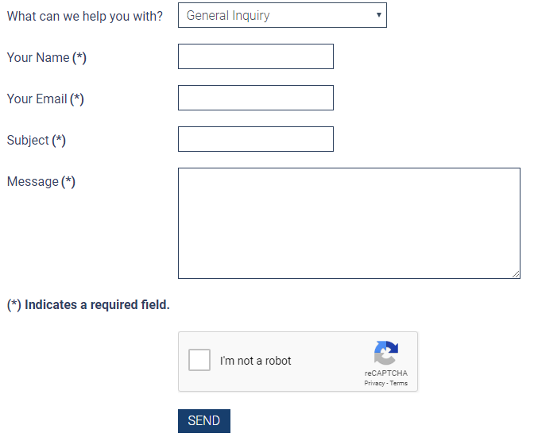
RSForms!Pro Demos
Contact Form
http://temp.novahss.org/home/contact-us
Roommate Match Form (much more complex)
http://temp.novahss.org/about-the-roommate-i-match-service/roommates
Contact Form:

Slide 16
RSFormsPro! Backend

Slide 17
RSFormsPro! Backend – Manage Forms

Slide 18
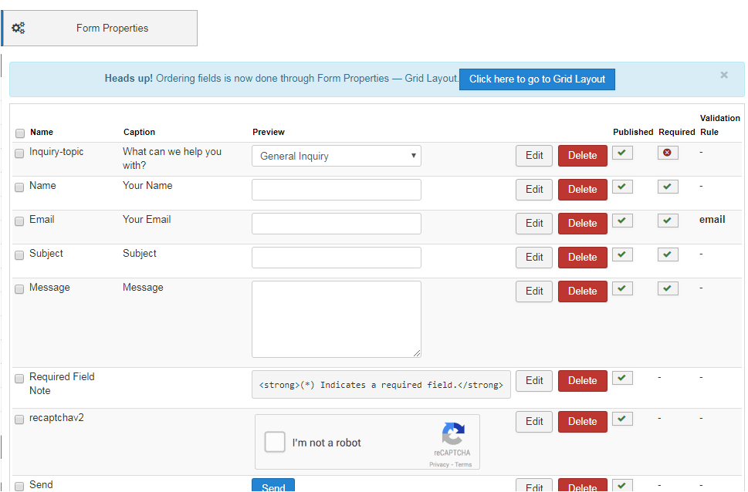
RSFormsPro! Backend – Contact Form
Contact Form – Form Fields

Slide 19
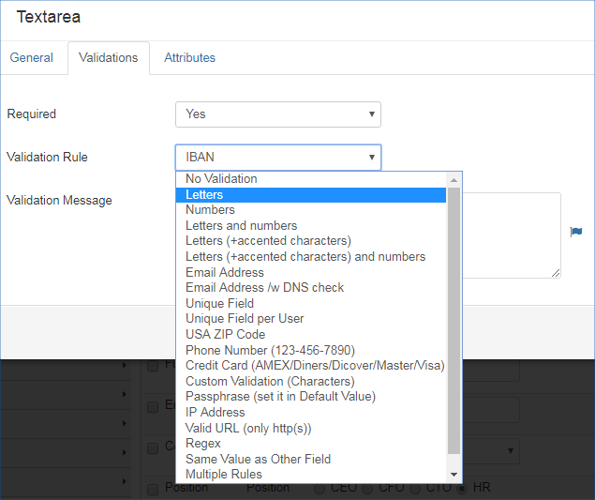
RSFormsPro! Backend - Validations
LOTS of
Validation for
Each field type!
Installs with example forms.
Option for Ajax validation as well!

Slide 20
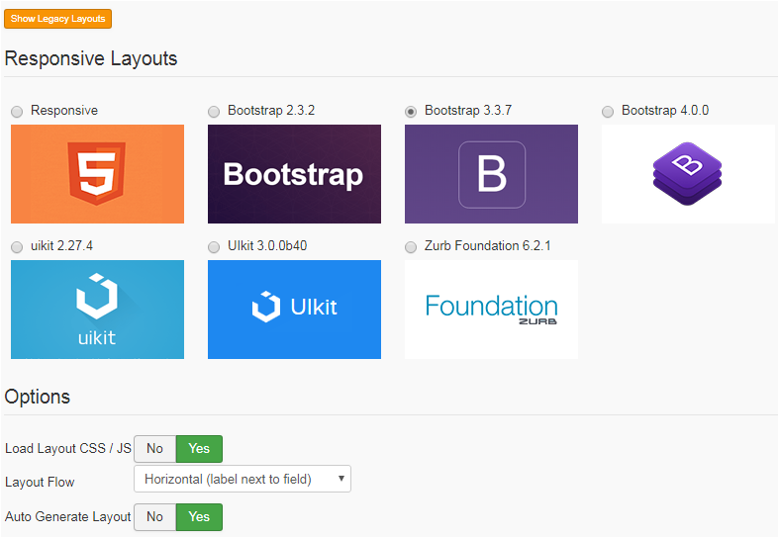
RSFormsPro! Backend –Layout
Plus – enter CSS, Javascript and PHP scripts as needed.

Slide 21
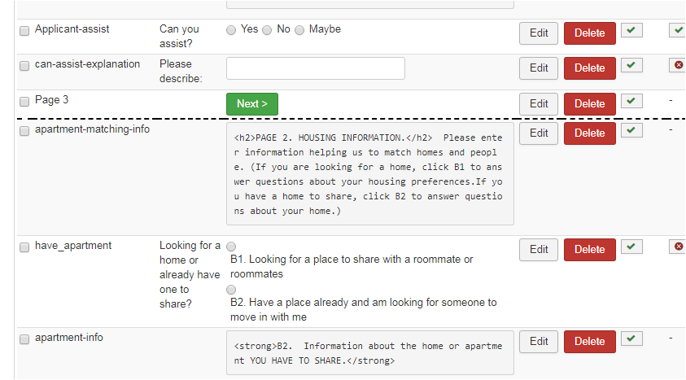
RSFormsPro! Backend –Layout – Multi-page forms

Slide 22
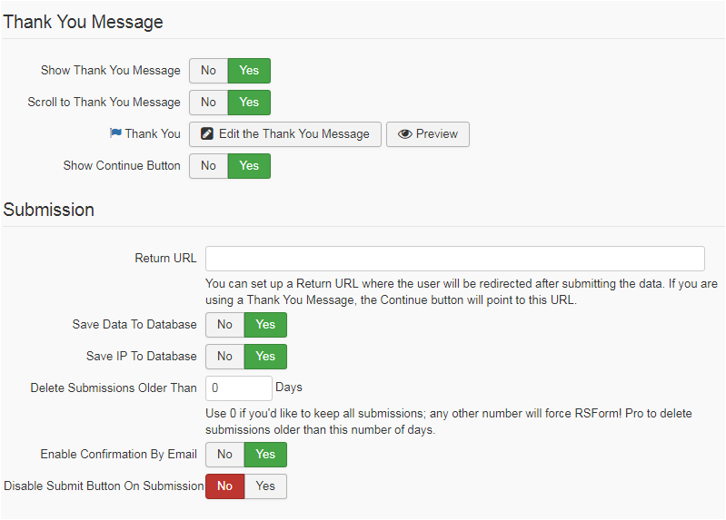
RSFormsPro! Backend –Submission

Slide 23
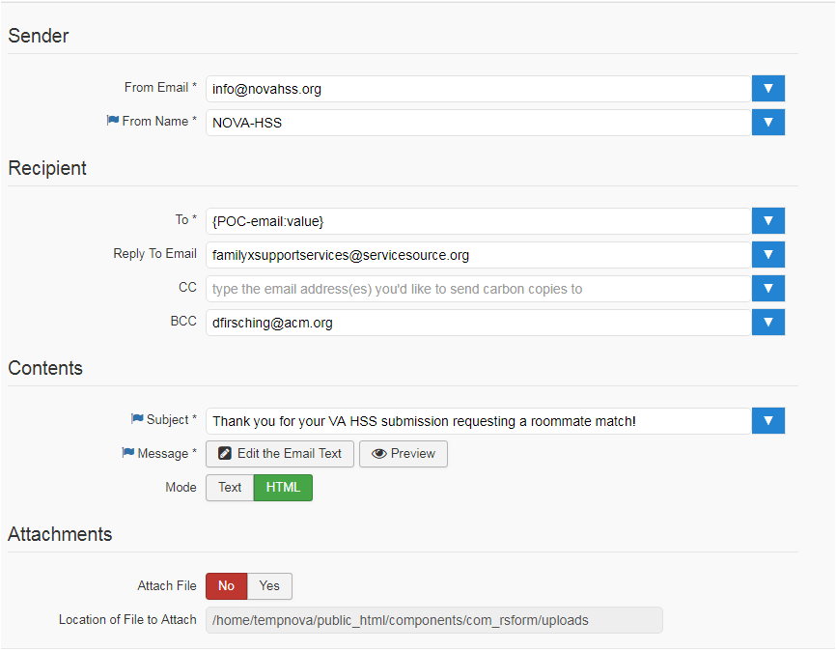
RSFormsPro! Backend –Emails

Slide 24
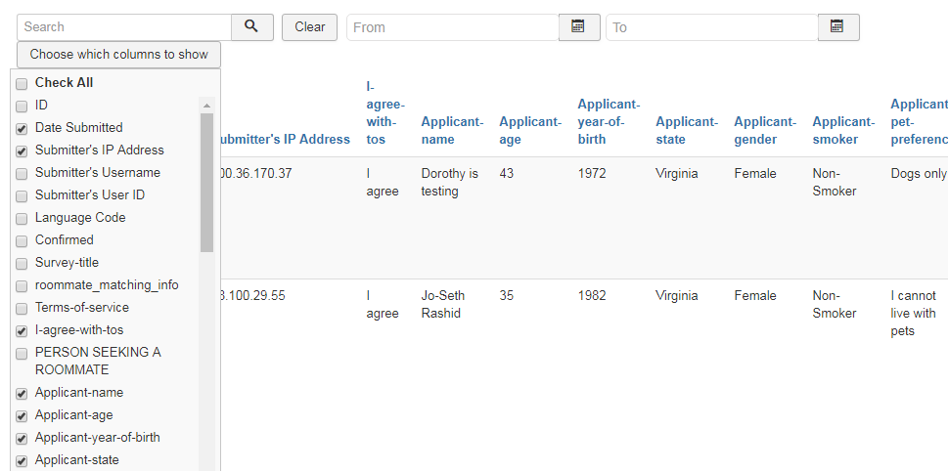
RSForms!Pro – Manage Submissions

Slide 25
RSForms!Pro – Exports
Also mappings to database tables, if you know what you’re doing:
Also (silent) posts to other locations (URLs)!

Slide 26
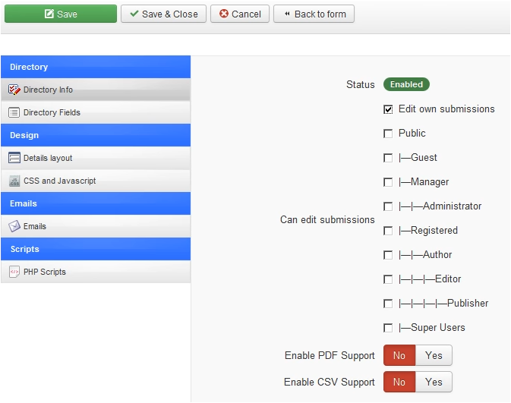
RSForms!Pro – Directories
Supports users editing their own submissions, and essentially building directories!
Control by field what is editable.
Create menu items.
Tutorial video: https://www.rsjoomla.com/video-tutorials/rsformpro/ep-82-rsformpros-submissions-directory-feature.html

Slide 27
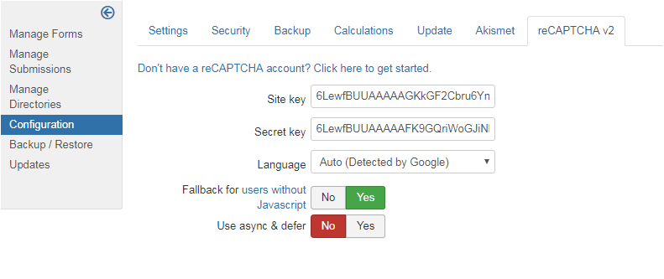
RSForms Pro - Recaptcha v2

Slide 28
RSForms Pro – Backup / Restore
Backup forms and restore to move between systems, e.g., test to live
Include submissions or just the form
Overwrite existing forms or not; keep form IDs from backup or not

Slide 29
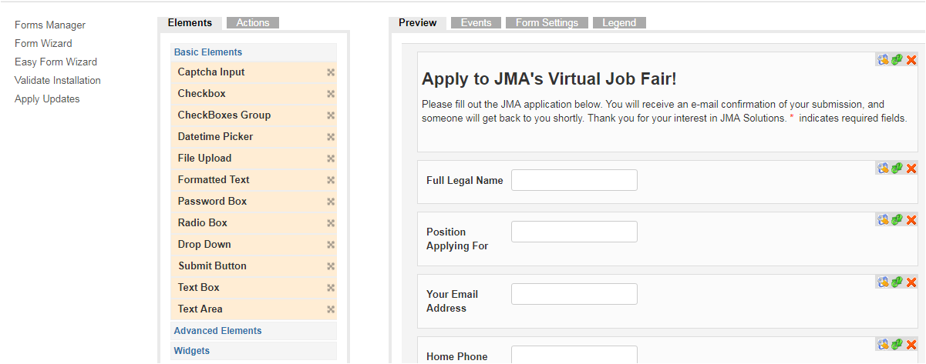
Chronoforms - Fields

Slide 30
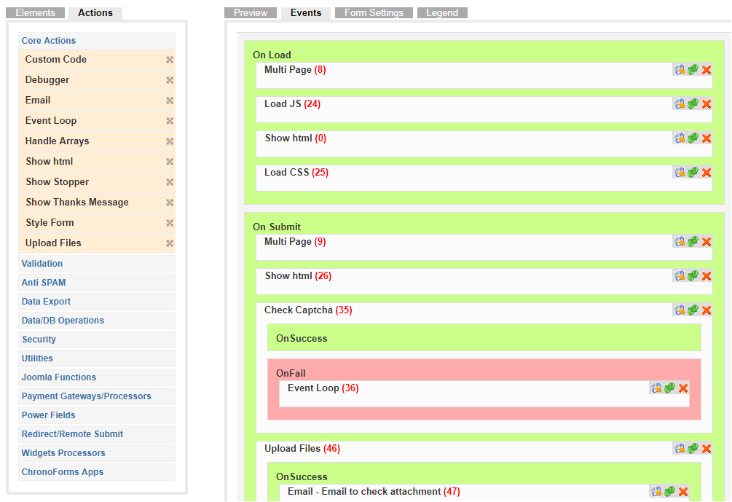
Chronoforms - Events
Lots of control, but for complex forms, more challengingthan RS Forms Pro.

Slide 31
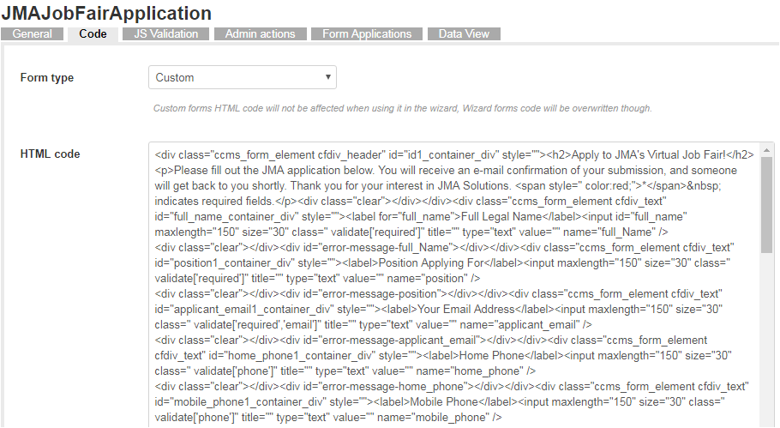
Chronoforms - Customization

Slide 32
Discussion

