Slide 1
Joomla! Updates
Northern Virginia Joomla Users Group
January, 2019
Dorothy Firsching, Ursa Major Consulting, LLC
dfirsching@ursamajorconsulting.com

Slide 2
Agenda
Joomla! Updates
Upcoming JUG Meetings
Dwayne Grimes – Upgrades and content transfer
Topics for Future - Discussion

Slide 3
Joomla! Updates
Joomla! 3.9.2 Release – Jan. 15, 2019
Fixes 4 low priority security vulnerabilities affecting Joomla! 2.5.0 thru 3.9.1
Over 50 bug fixes and improvements
https://www.joomla.org/announcements/release-news/5755-joomla-3-9-2-release.html
Joomla! 3.9 – The Privacy Tool Suite
User Consents to privacy policy and/or terms and conditions
Time-based consent expiration
Track and manage information access or removal requests by users
Plugin event for extension developers onPrivacycollectAdminCapabilities
User Actions Log
And other enhancements…

Slide 4
Joomla! 3.9 Enhancements
User Actions Log – who’s done what, and when, and emails
Article Notes
Backend Article Search of Text and Notes
Before, it was just the title
Load module by Module ID
{loadposition} as before, or {loadmodule} with module name
{loadmodule: 111}
Repeatable Custom Fields
Alternative layouts for Custom Fields (like template override)
Google Invisible reCAPTCHA
Latest articles by a specific author
More image display options in the Newsflash

Slide 5
Upcoming Joomla! Releases
Joomla! 3.10 – last of Joomla! 3.x Series – late 2019
API changes prior to Joomla! 4.0
Will be supported for 2 years after release
Joomla! 4.0 – late 2019
During 2018, there were 4 Alpha releases of Joomla! 4
Requires PHP 7
Many updates – see next page

Slide 6
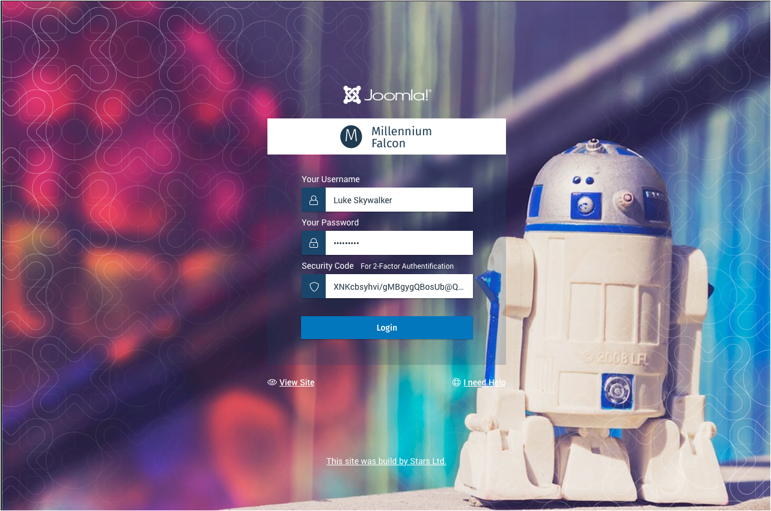
Major Release – Joomla! 4.0
Numerous Improvements
New Media Manager
Publishing Workflow
Restructured backend
Accessibility
New Menu Logic
New Dashboard
Customized Columns
Web Services
Prepared SQL Statements
Schedule
Alpha is out
Stable due in 2019

Slide 7
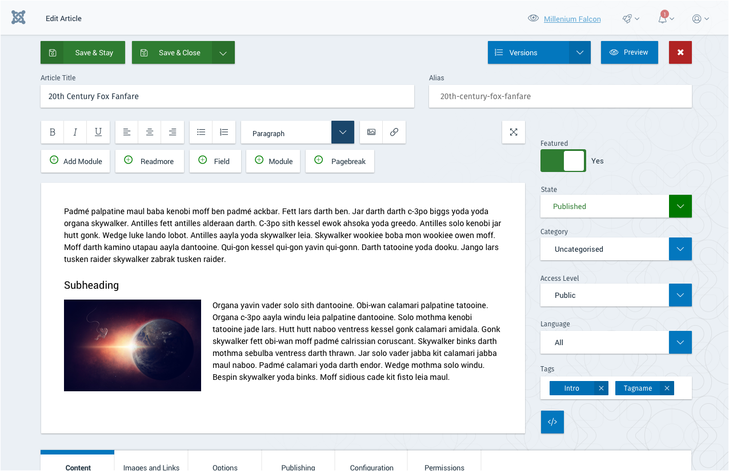
Joomla! 4.0 Look

Slide 8
Upcoming NOVA JUG Events
Monday, February 25, 2019: Kings Park
Monday, March 25, 2019: Kings Park
Monday, April 22, 2019: Kings Park
Hold thoughts on topics…

Slide 9
Other Joomla! Events
Joomla users Group of NJ - https://joomlausersnj.com/
Recently, had Steve Burge give an overview of Joomla! 3.9.
Video: https://www.freeconferencecall.com/wall/recorded_audio?audioRecordingUrl=https%3A%2F%2Frs0000.freeconferencecall.com%2Fstorage%2FsgetFCC2%2FHbk37%2FaRWpZ&subscriptionId=6048440
JUG Chicago North (JUGCN) – joomlachicagonorth.com
Feb. 13, 11:00 AM, Exploring CSS Grid In the beta of Joomla 4, the Cassiopeia template uses the CSS Grid. What is CSS Grid? How does it work? How does it compare to Bootstrap? Terry Bjork of Terryburg Development will lead this session.
March 13, 11:00 AM, MyJoomla.com MyJoomla has been a go-to for fixing hacked sites for years. It is a subscription service that offers so much more. There is a suite of tools useful for securing your Joomla site. Join us to discuss what they are and how to use them.

Slide 10
Upcoming JoomlaDays
Florida: Tampa, FL Feb. 22-24, 2019 https://joomladayflorida.com/ The Premier North American Joomla Event
JoomlaDay Florida brings together web designers, integrators, developers, and marketers for an annual weekend event. Our past events have sold out months to weeks before the event, and JoomlaDay Florida is currently the largest attended Joomla Day in the United States. This year's three-day schedule will kick off with an afternoon of workshops and Joomla Certification and Friday, Feb 22nd, with a VIP Event on Friday night. The event continues with a full day of sessions on Saturday, Feb 23rd and our Networking Party in the evening. JoomlaDay Florida 2019 will conclude with a full day of labs on Sunday, Feb 24th.
France: March 8, 2019
Israel: March 27, 2019
Austria: March 29-30, 2019, Vienna https://joomla-day.at/de/aktuell/69-joomladay-programm-2019
3 tracks, 2 days, at least 20 lectures and 3 workshops:
"Git" am Freitag vormittag
"J4 Komponenten Upgrade" am Freitag nachmittag und
"SEO" am Samstag vormittag
Australia: August 30, 2019
Chicago: October 2019

Slide 11
Topic List from Chicago North JUG Plus Others
Securing Your Joomla Site
Quick Site Builds
CRM: Jinbound
CRM for Non-profits: CiviCRM
Framework: Gantry
Framework: Helix
Framework: T3
eCommerce: J2Store
Marketing Automation
EasyArticles
Multilingual Sites
EasyBlog
Tools your Joomla Agency Needs

Slide 12
Requests?

Slide 13
Security Tidbits for the Day
Turn on User Logging
Set it to email you if someone logs into the backend and takes certain actions
Turn on 2-factor authentication
Avoid brute forcing of your password

